Slide 1
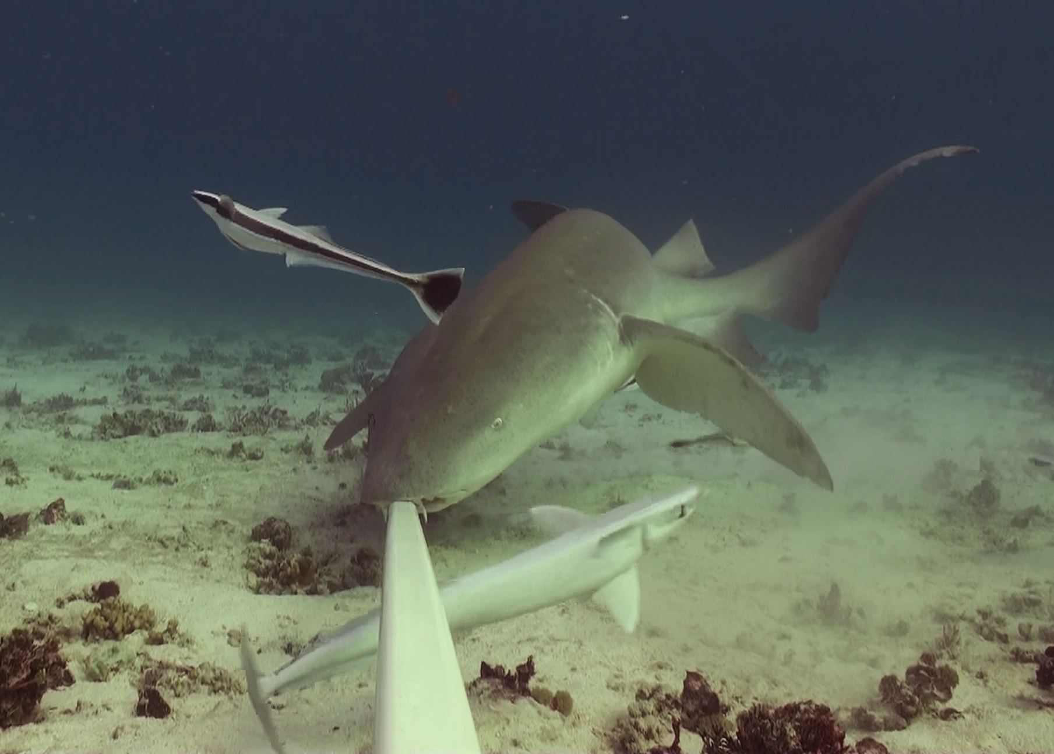
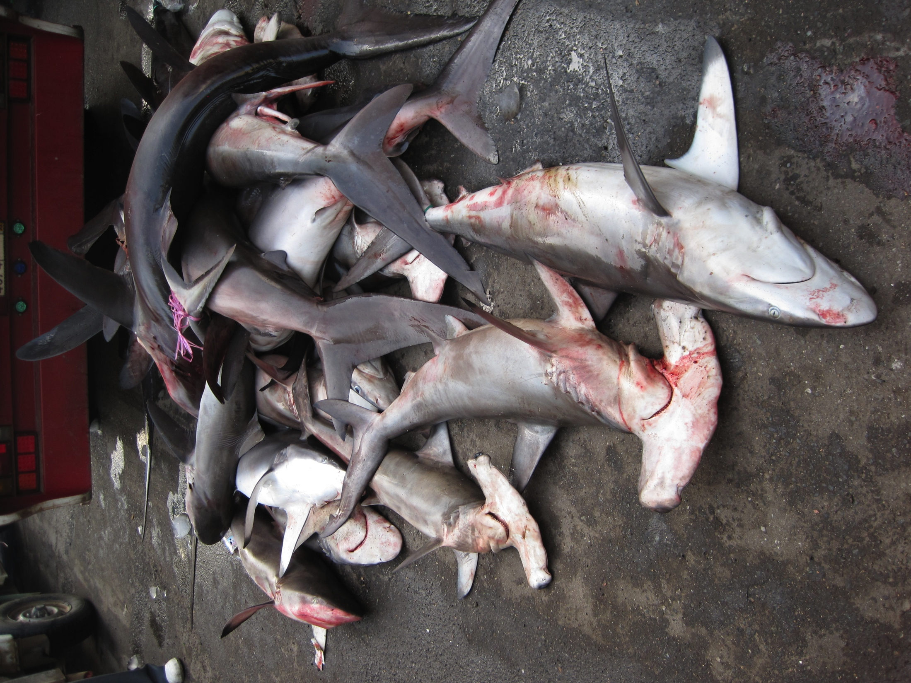
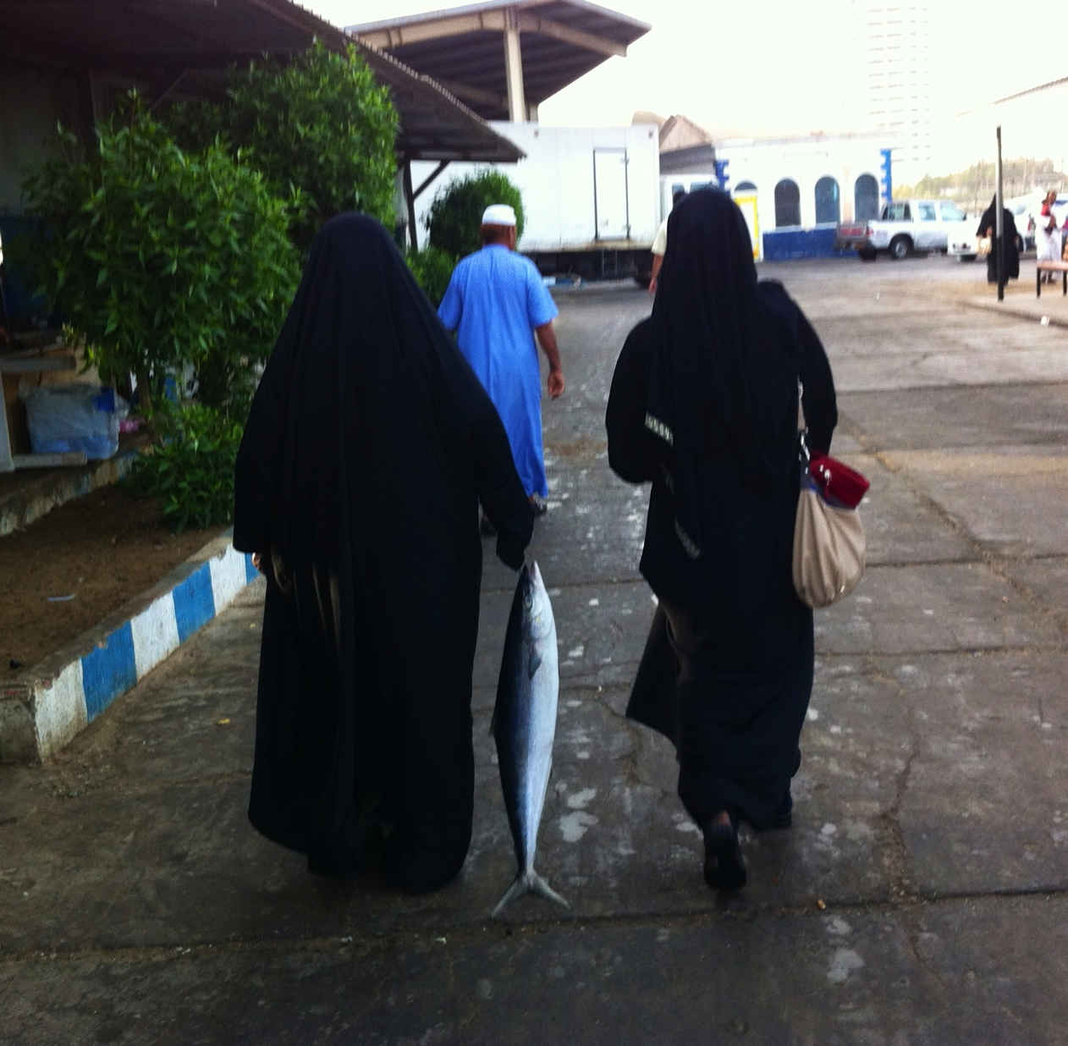
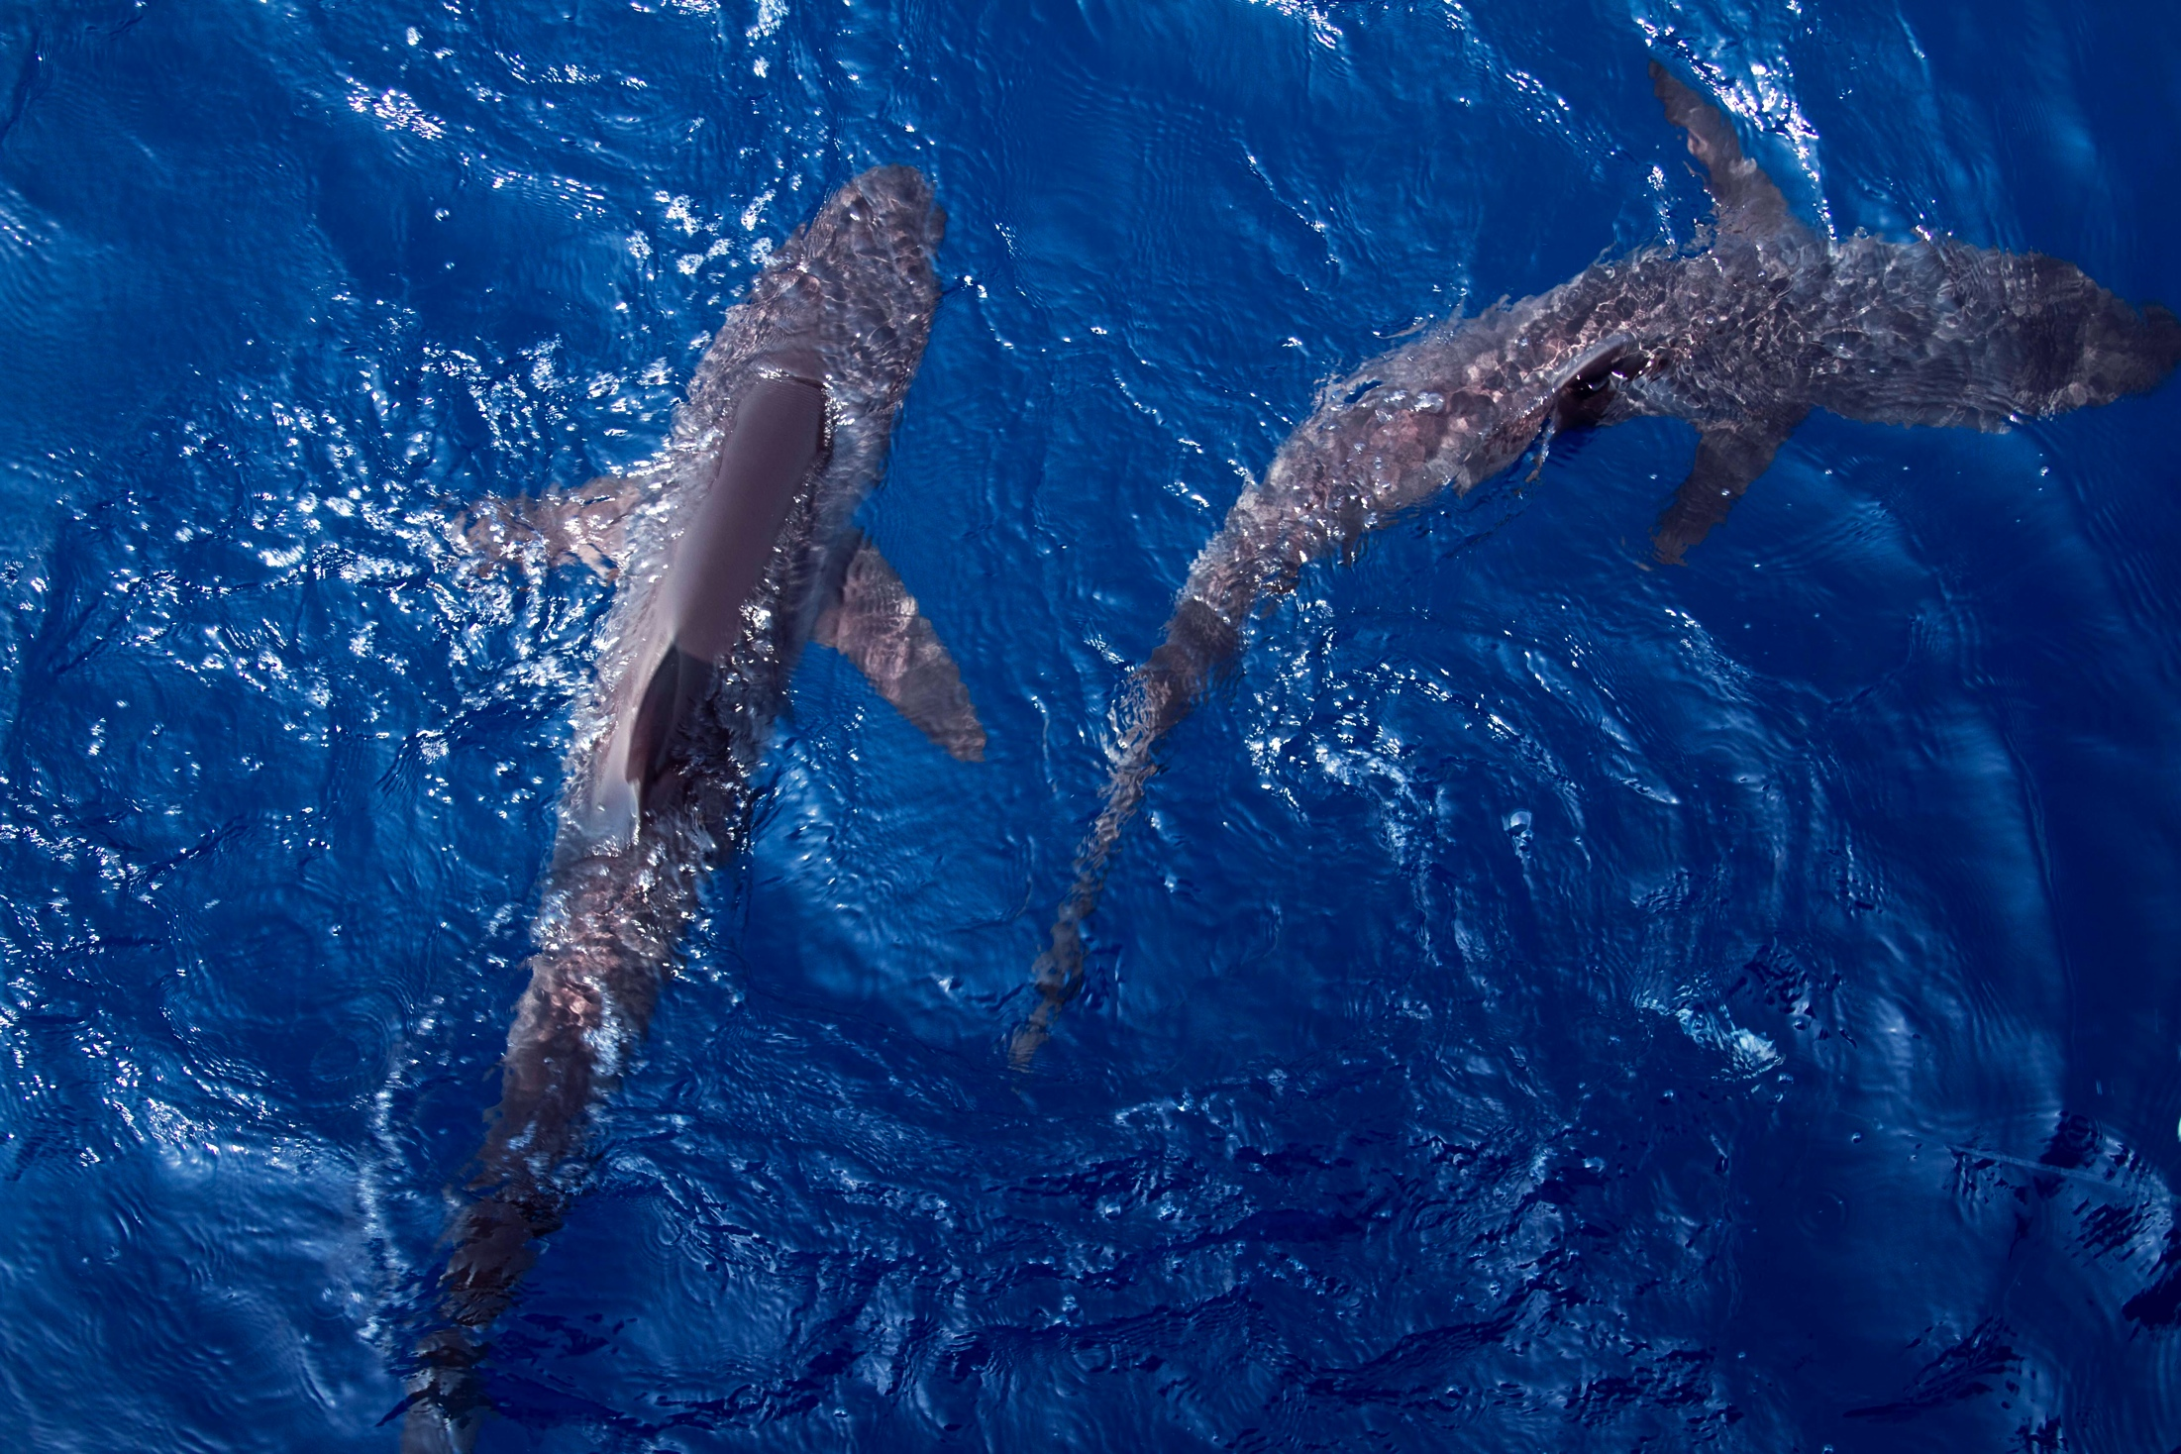
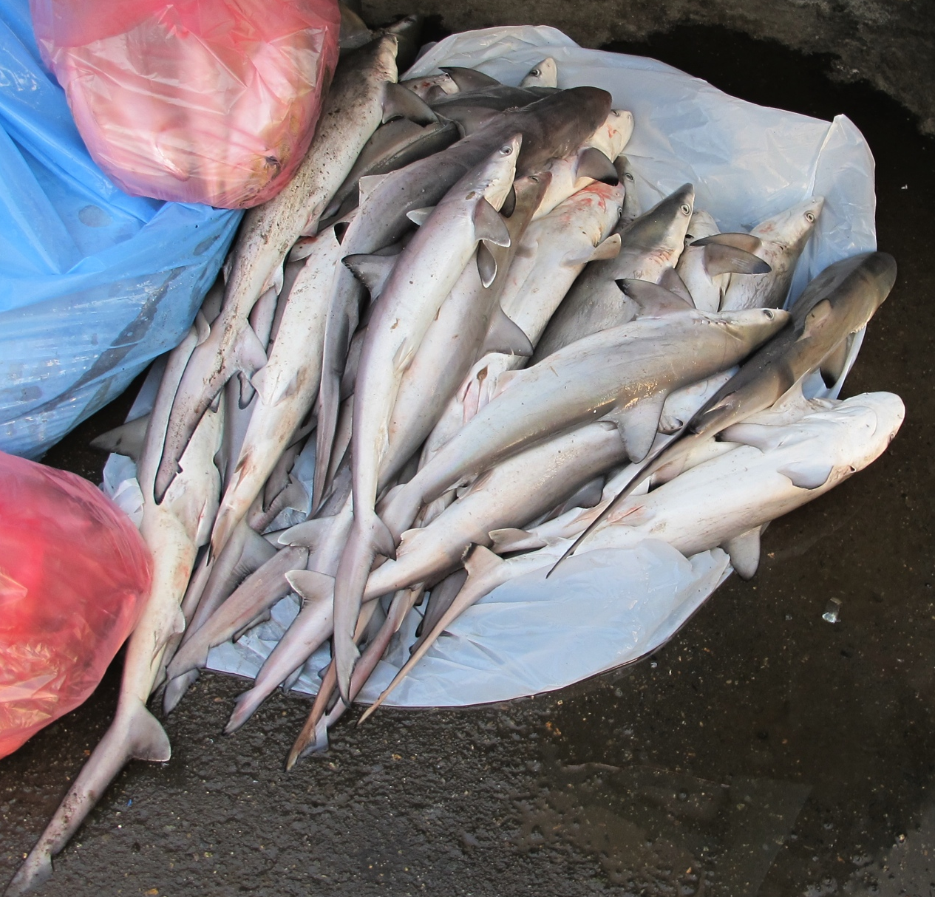

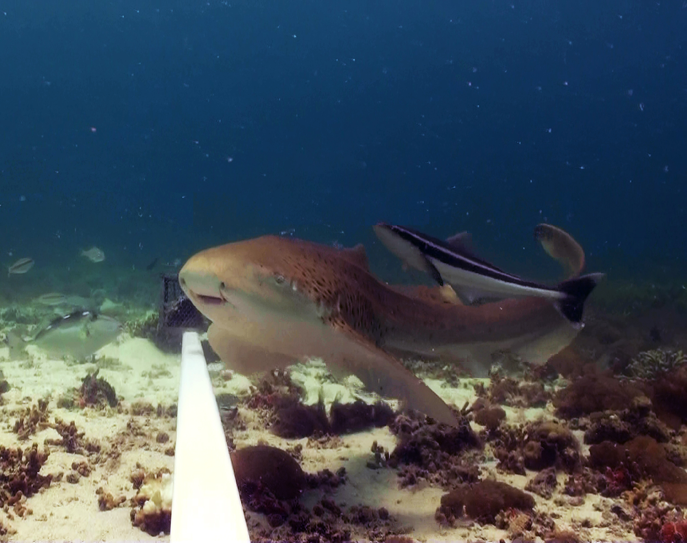
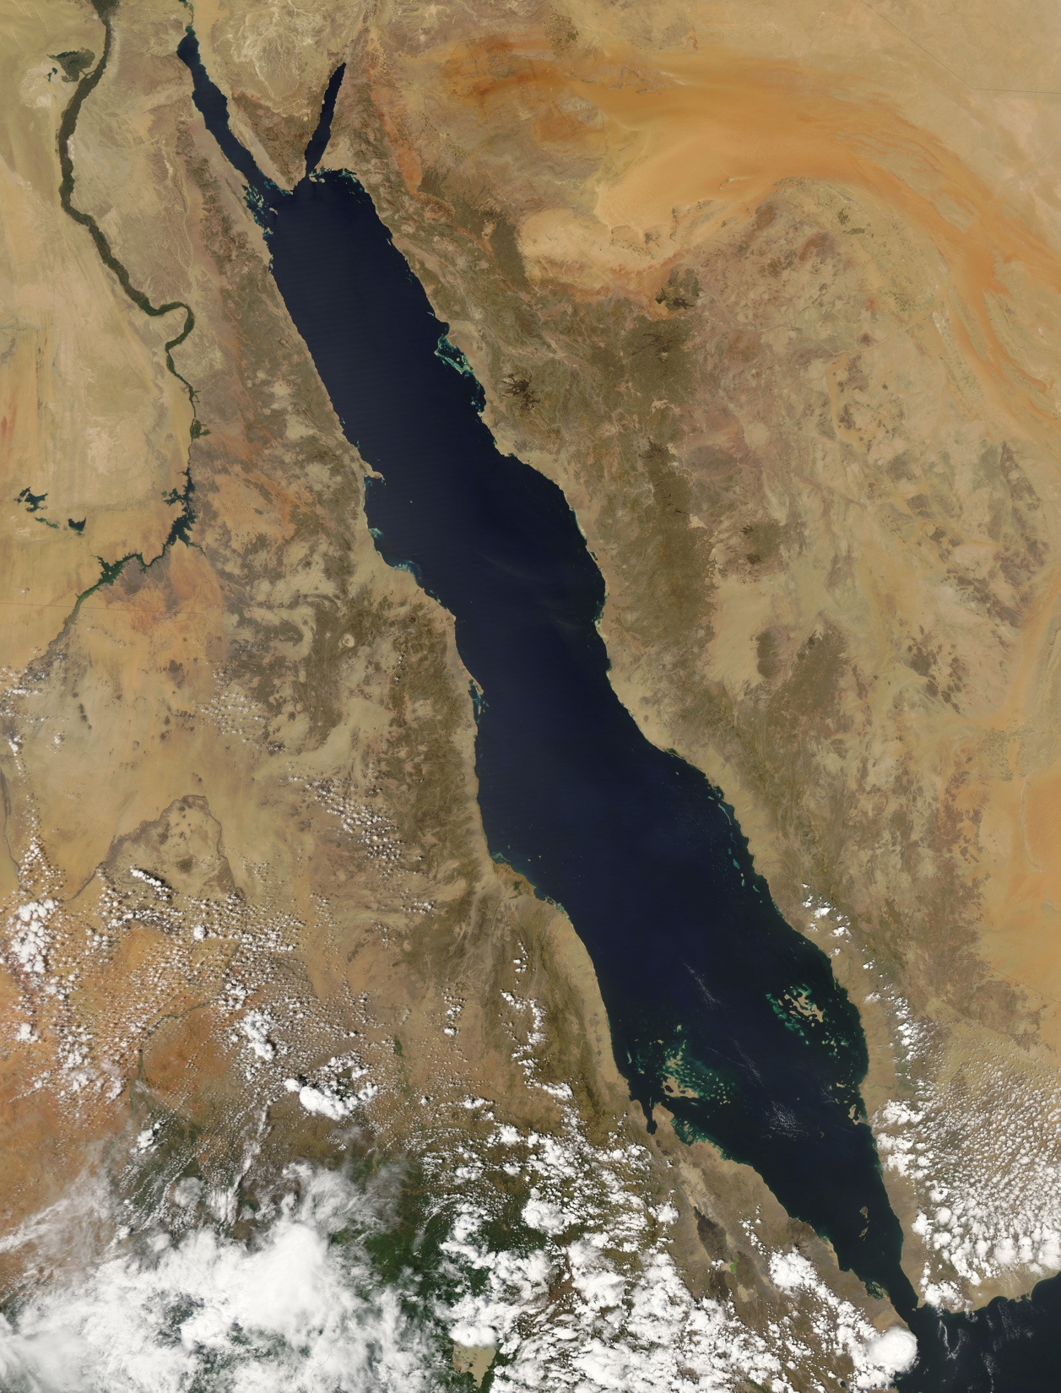
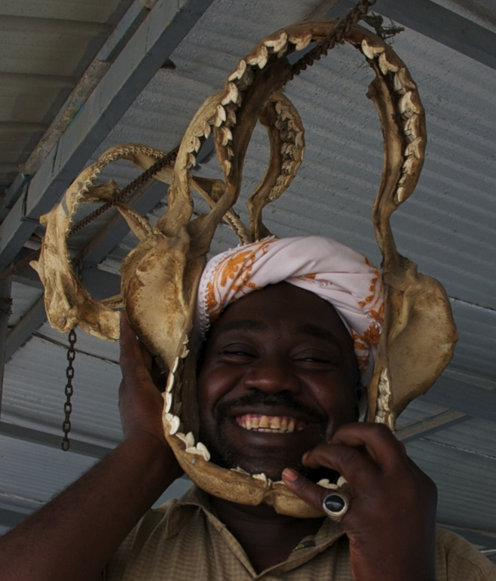
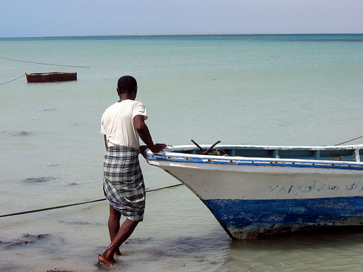
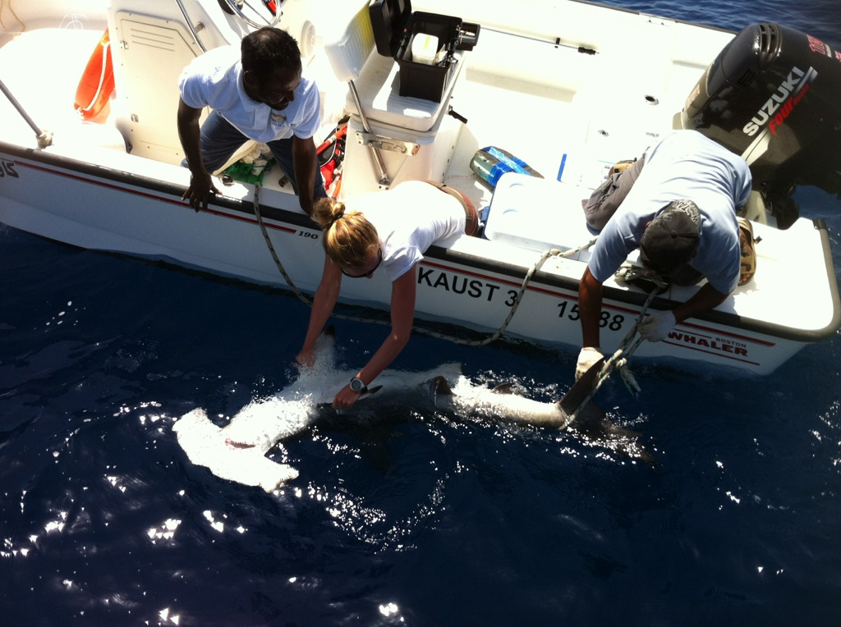
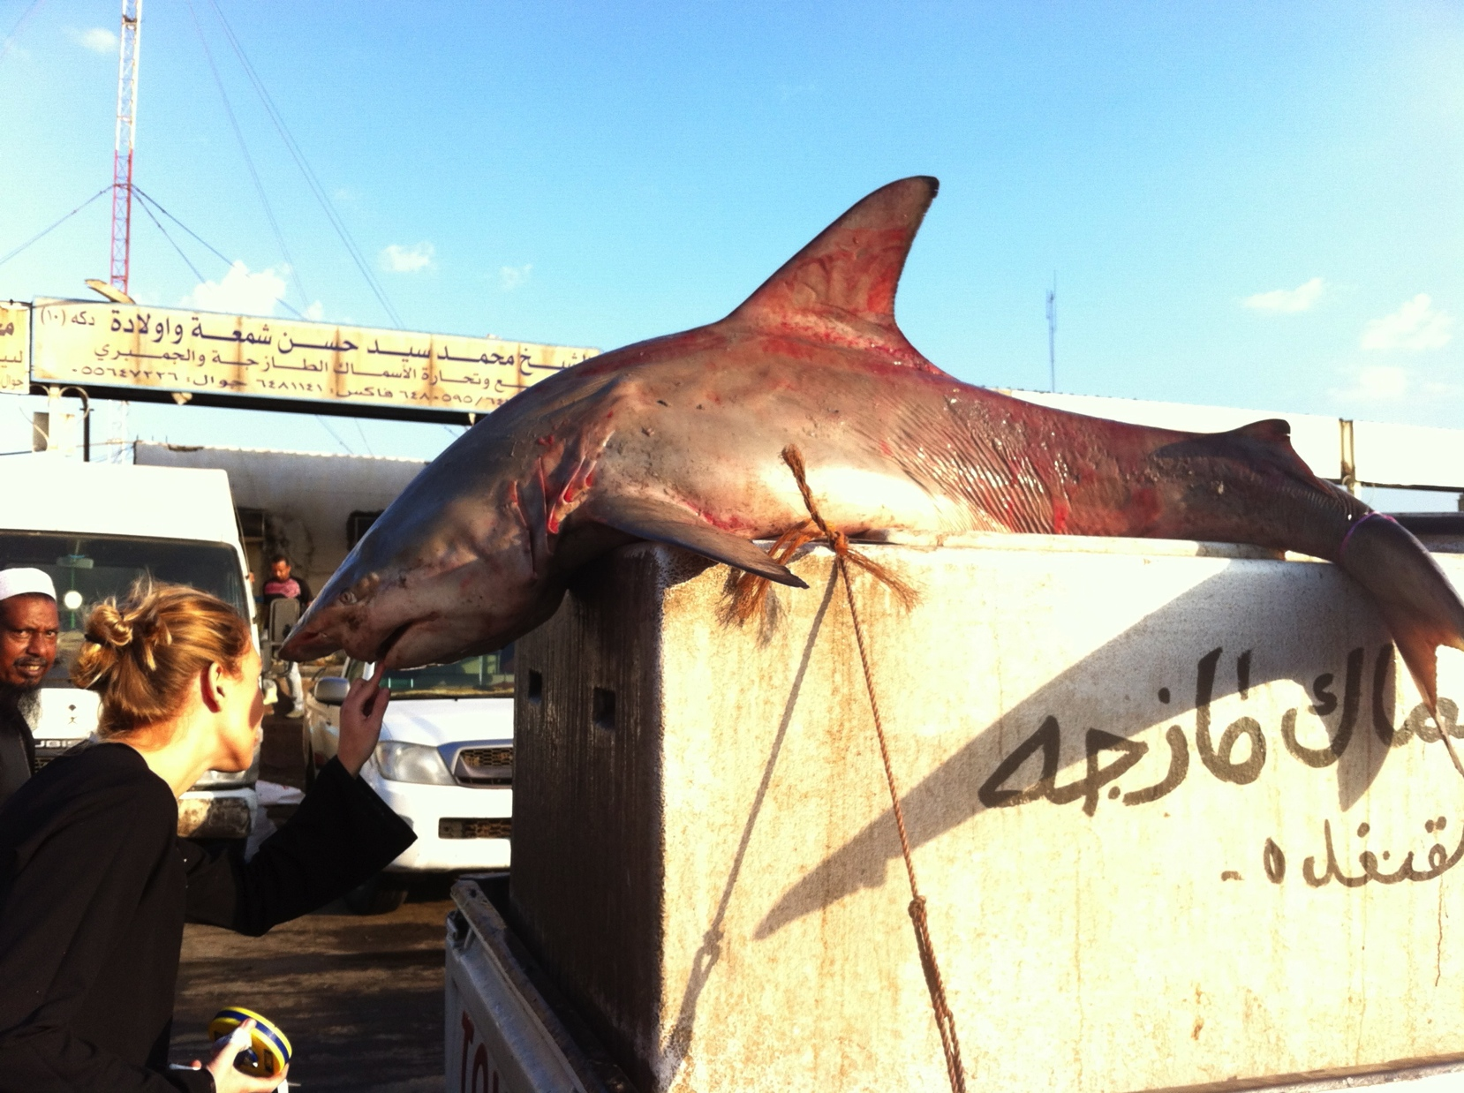
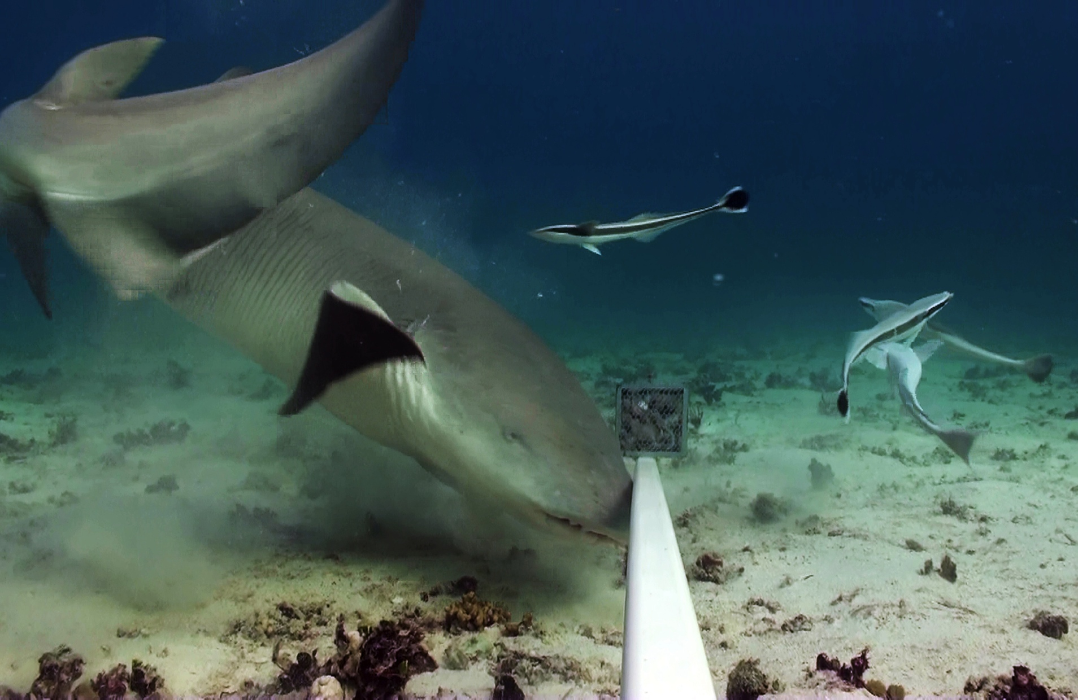


The current status of sharks in the Red Sea
Julia Spaet
julia.spaet@kaust.edu.sa
Michael Berumen
Gregory Skomal
Red Sea Research Center
King Abdullah University of Science and Technology
Notes:
I’m currently conducting my PhD in Saudi Arabia investigating Red Sea elasmobranch populations and in my presentation today will discuss the current status of sharks in the Red Sea based on some preliminary data.

Slide 2
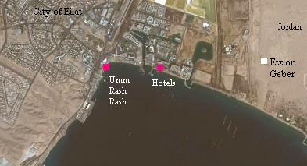
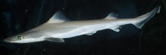


Current
knowledge
Project
objectives
Market
surveys
Fishermen
Interviews
BRUVS/
Longlines
Future
research
Abundance
Distribution
Movements
Genetic connectivity
Key habitats
200 km
Spaet et al. 2012, JFishBio
Red Sea Research Center
King Abdullah University of Science and Technology
Notes:
The currently available scientific information on Red Sea sharks is extremely limited. The dots on this map identify sites in the Red Sea for which scientific information on sharks is available. Most of these studies however are purely observational reports, species descriptions or random notes on e.g. a shark attack or a new species of shark parasite but studies that would help us to gain a general understanding of Red Sea sharks, e.g. studies on life history aspects, genetic relationships or stock assessment studies are completely missing. The big dot up here in the Gulf of Aqaba represents an accumulation of studies conducted in the region around Eilat in Israel, which is of all Red Sea countries the one with the shortest coastline, it’s only 12km long. Even though quite a few studies have been conducted up there almost all of them are exclusively based on physiological aspects of the oman shark, Iago omanensis so again there is not much general information to be gained from those. There is some information on shark diversity but it seems that even current species estimates of 29 shark species are far from being complete
2

Slide 3
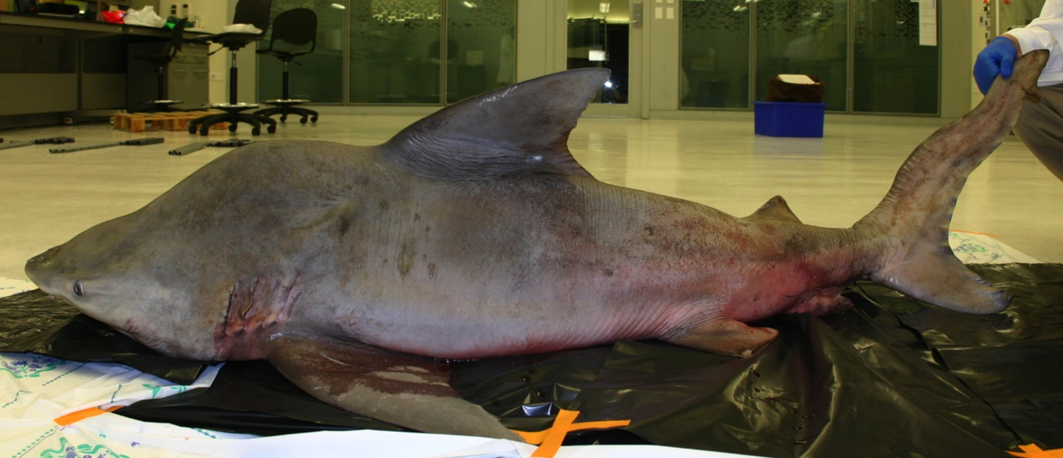
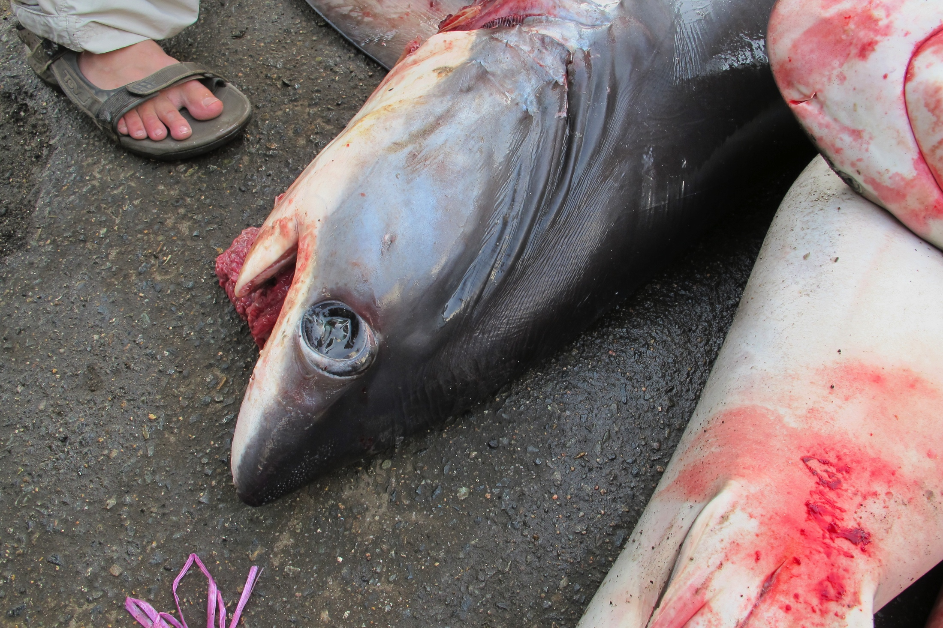
Current
knowledge
Project
objectives
Market
surveys
Fishermen
Interviews
BRUVS/
Longlines
Future
research
A. superciliosus
C. amboinensis
200 km
Spaet et al. 2011, ZooMidEast
Red Sea Research Center
King Abdullah University of Science and Technology
Notes:
The currently available scientific information on Red Sea sharks is extremely limited. The dots on this map identify sites in the Red Sea for which scientific information on sharks is available. Most of these studies however are purely observational reports, species descriptions or random notes on e.g. a shark attack or a new species of shark parasite but studies that would help us to gain a general understanding of Red Sea sharks, e.g. studies on life history aspects, genetic relationships or stock assessment studies are completely missing. The big dot up here in the Gulf of Aqaba represents an accumulation of studies conducted in the region around Eilat in Israel, which is of all Red Sea countries the one with the shortest coastline, it’s only 12km long. Even though quite a few studies have been conducted up there almost all of them are exclusively based on physiological aspects of the oman shark, Iago omanensis so again there is not much general information to be gained from those. There is some information on shark diversity but it seems that even current species estimates of 29 shark species are far from being complete
3

Slide 4

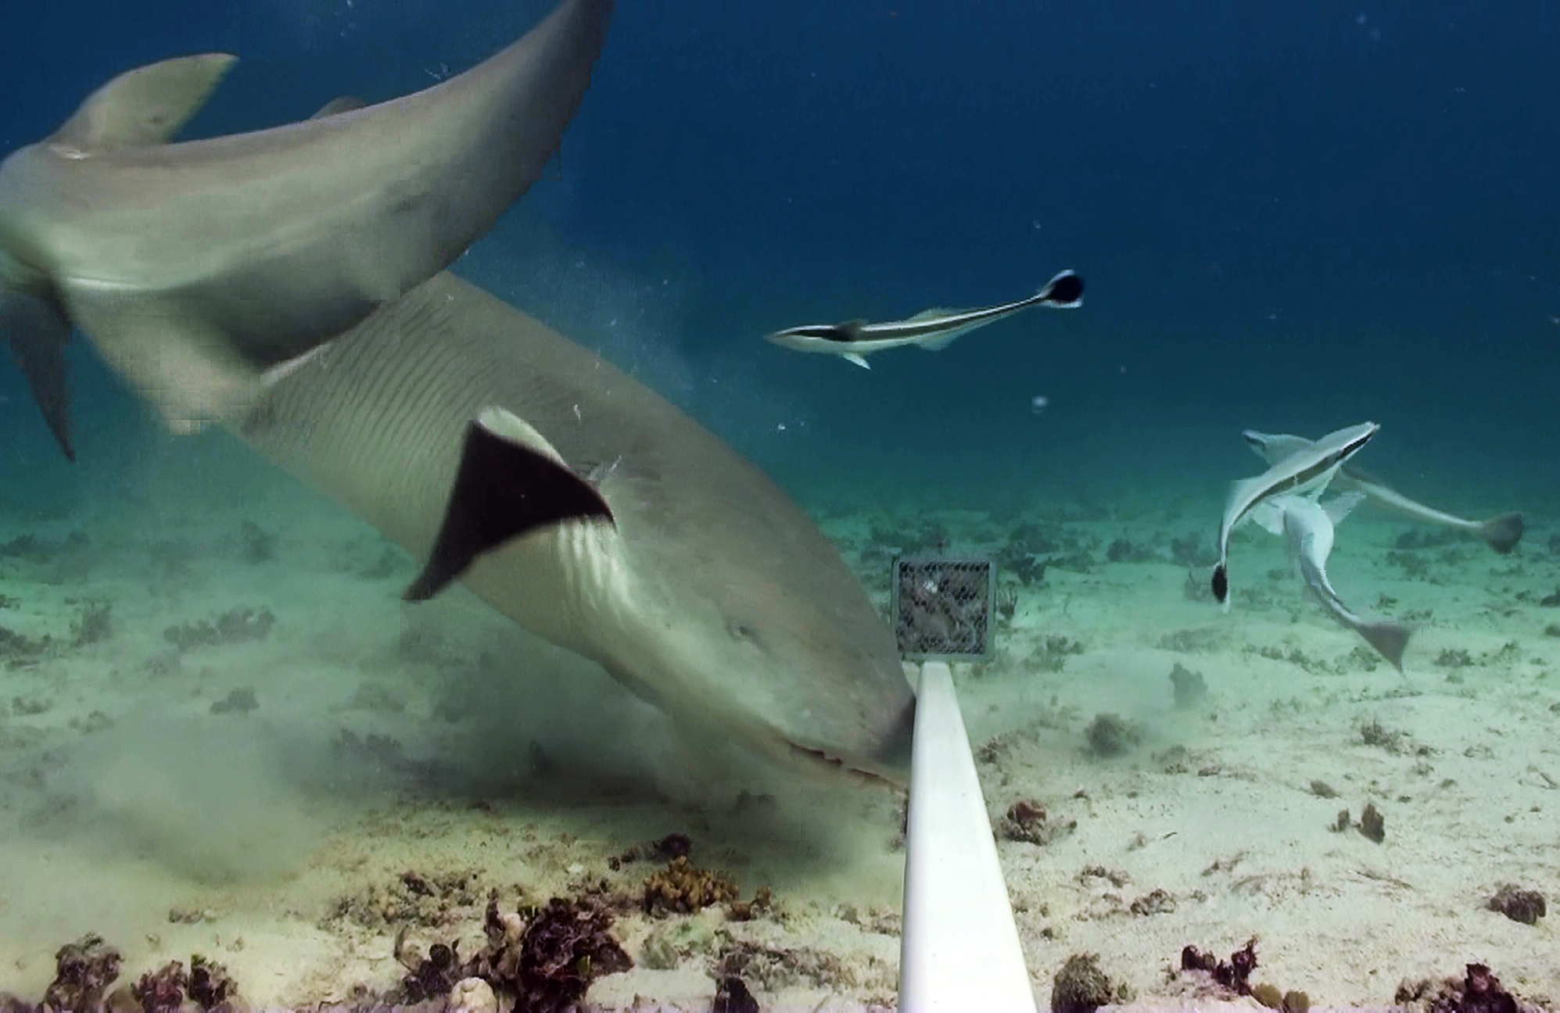
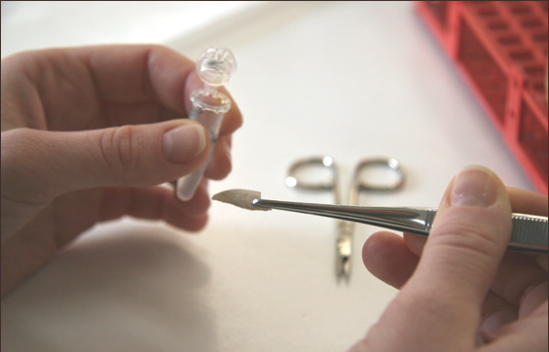
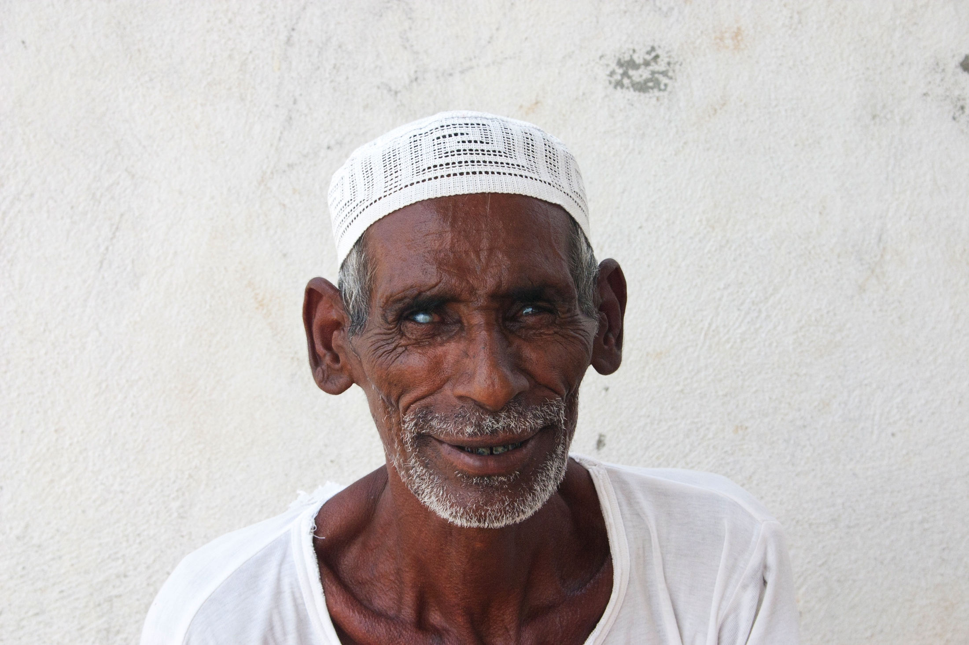
Current
knowledge
Project
objectives
Market
surveys
Fishermen
Interviews
BRUVS/
Longlines
Future
research
Market surveys
Baited Remote
Underwater Video Surveys
Genetic analysis
Fishermen interviews
Longline Surveys
Red Sea Research Center
King Abdullah University of Science and Technology
Notes:
The aim of this project is to gain some basic information on the diversity, abundance, movement patterns and population dynamics of shark species in the Red Sea with a combination of a range of fisheries dependent and independent methods including fish market surveys,
4

Slide 5
Current
knowledge
Project
objectives
Market
surveys
Fishermen
Interviews
BRUVS/
Longlines
Future
research
Baited Remote
Underwater Video Surveys
Market surveys
Longline Surveys
Fishermen interviews
Genetic analysis
Red Sea Research Center
King Abdullah University of Science and Technology
Notes:
baited remote under water video
5

Slide 6
Current
knowledge
Project
objectives
Market
surveys
Fishermen
Interviews
BRUVS/
Longlines
Future
research
Fishermen interviews
Baited Remote
Underwater Video Surveys
Longline Surveys
Market surveys
Genetic analysis
Red Sea Research Center
King Abdullah University of Science and Technology
Notes:
and longline surveys including a tagging study
6

Slide 7
Current
knowledge
Project
objectives
Market
surveys
Fishermen
Interviews
BRUVS/
Longlines
Future
research
Fishermen interviews
Genetic analysis
Longline Surveys
Market surveys
Baited Remote
Underwater Video Surveys
Red Sea Research Center
King Abdullah University of Science and Technology
Notes:
Interviews with local fishermen to find out more about current and past shark fisheries
7

Slide 8
Current
knowledge
Project
objectives
Market
surveys
Fishermen
Interviews
BRUVS/
Longlines
Future
research
Genetic analysis
Market surveys
Fishermen interviews
Baited Remote
Underwater Video Surveys
Longline Surveys
Red Sea Research Center
King Abdullah University of Science and Technology
Notes:
and genetic analysis of shark tissue sampled during market visits and long-line operations.
Hoping that the collected data will provide a foundation for more refined characterization of the status of Red Sea sharks.
8

Slide 9
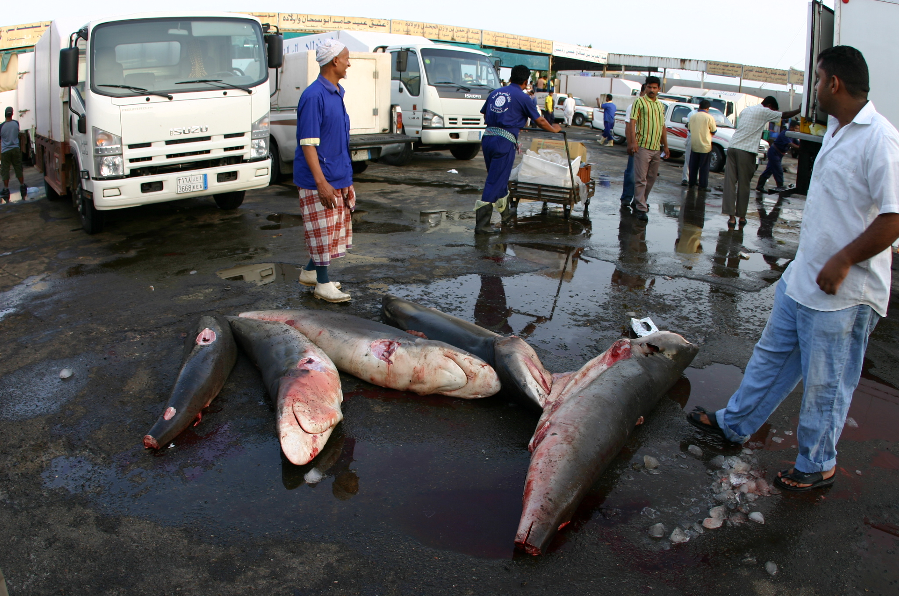
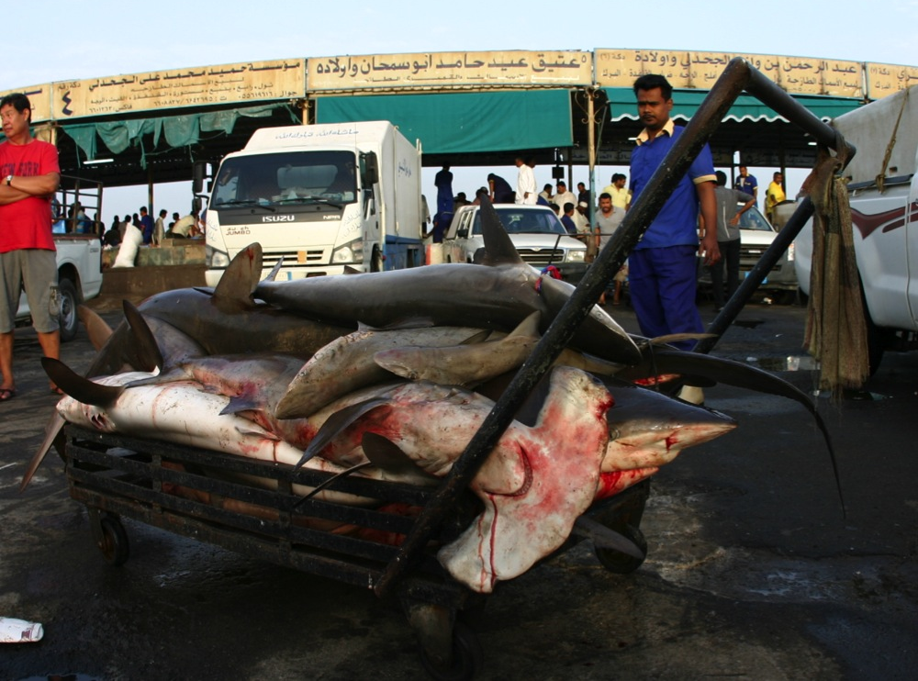
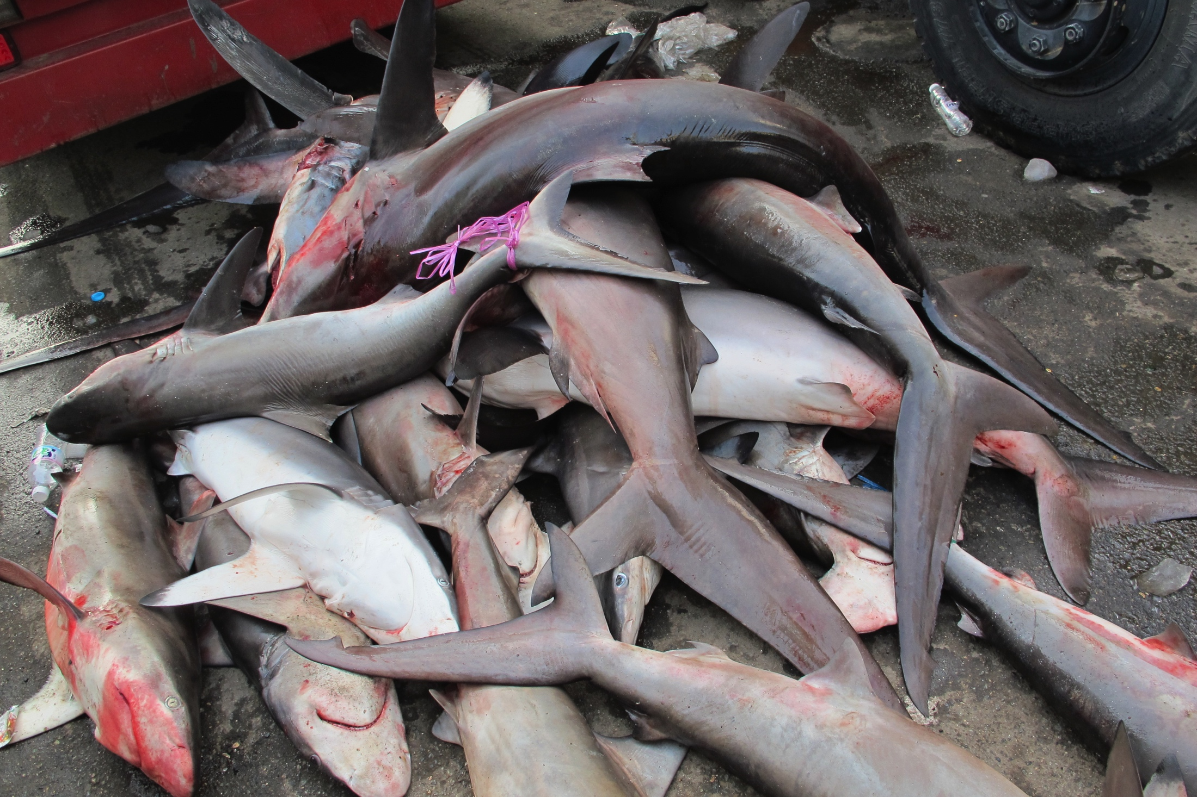
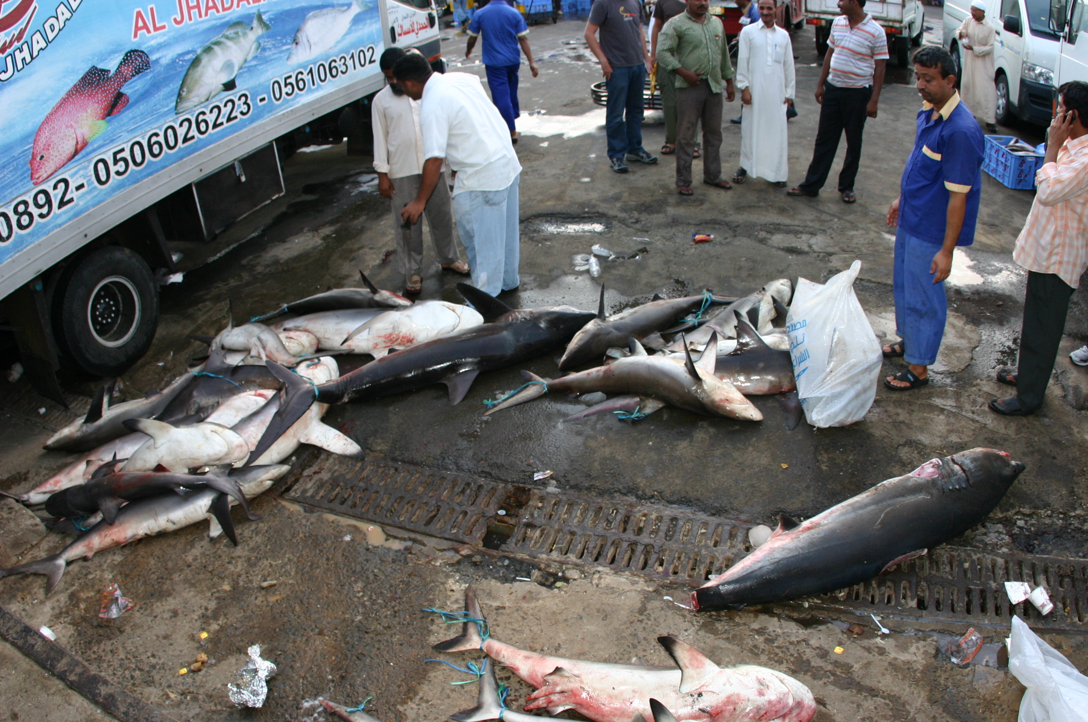
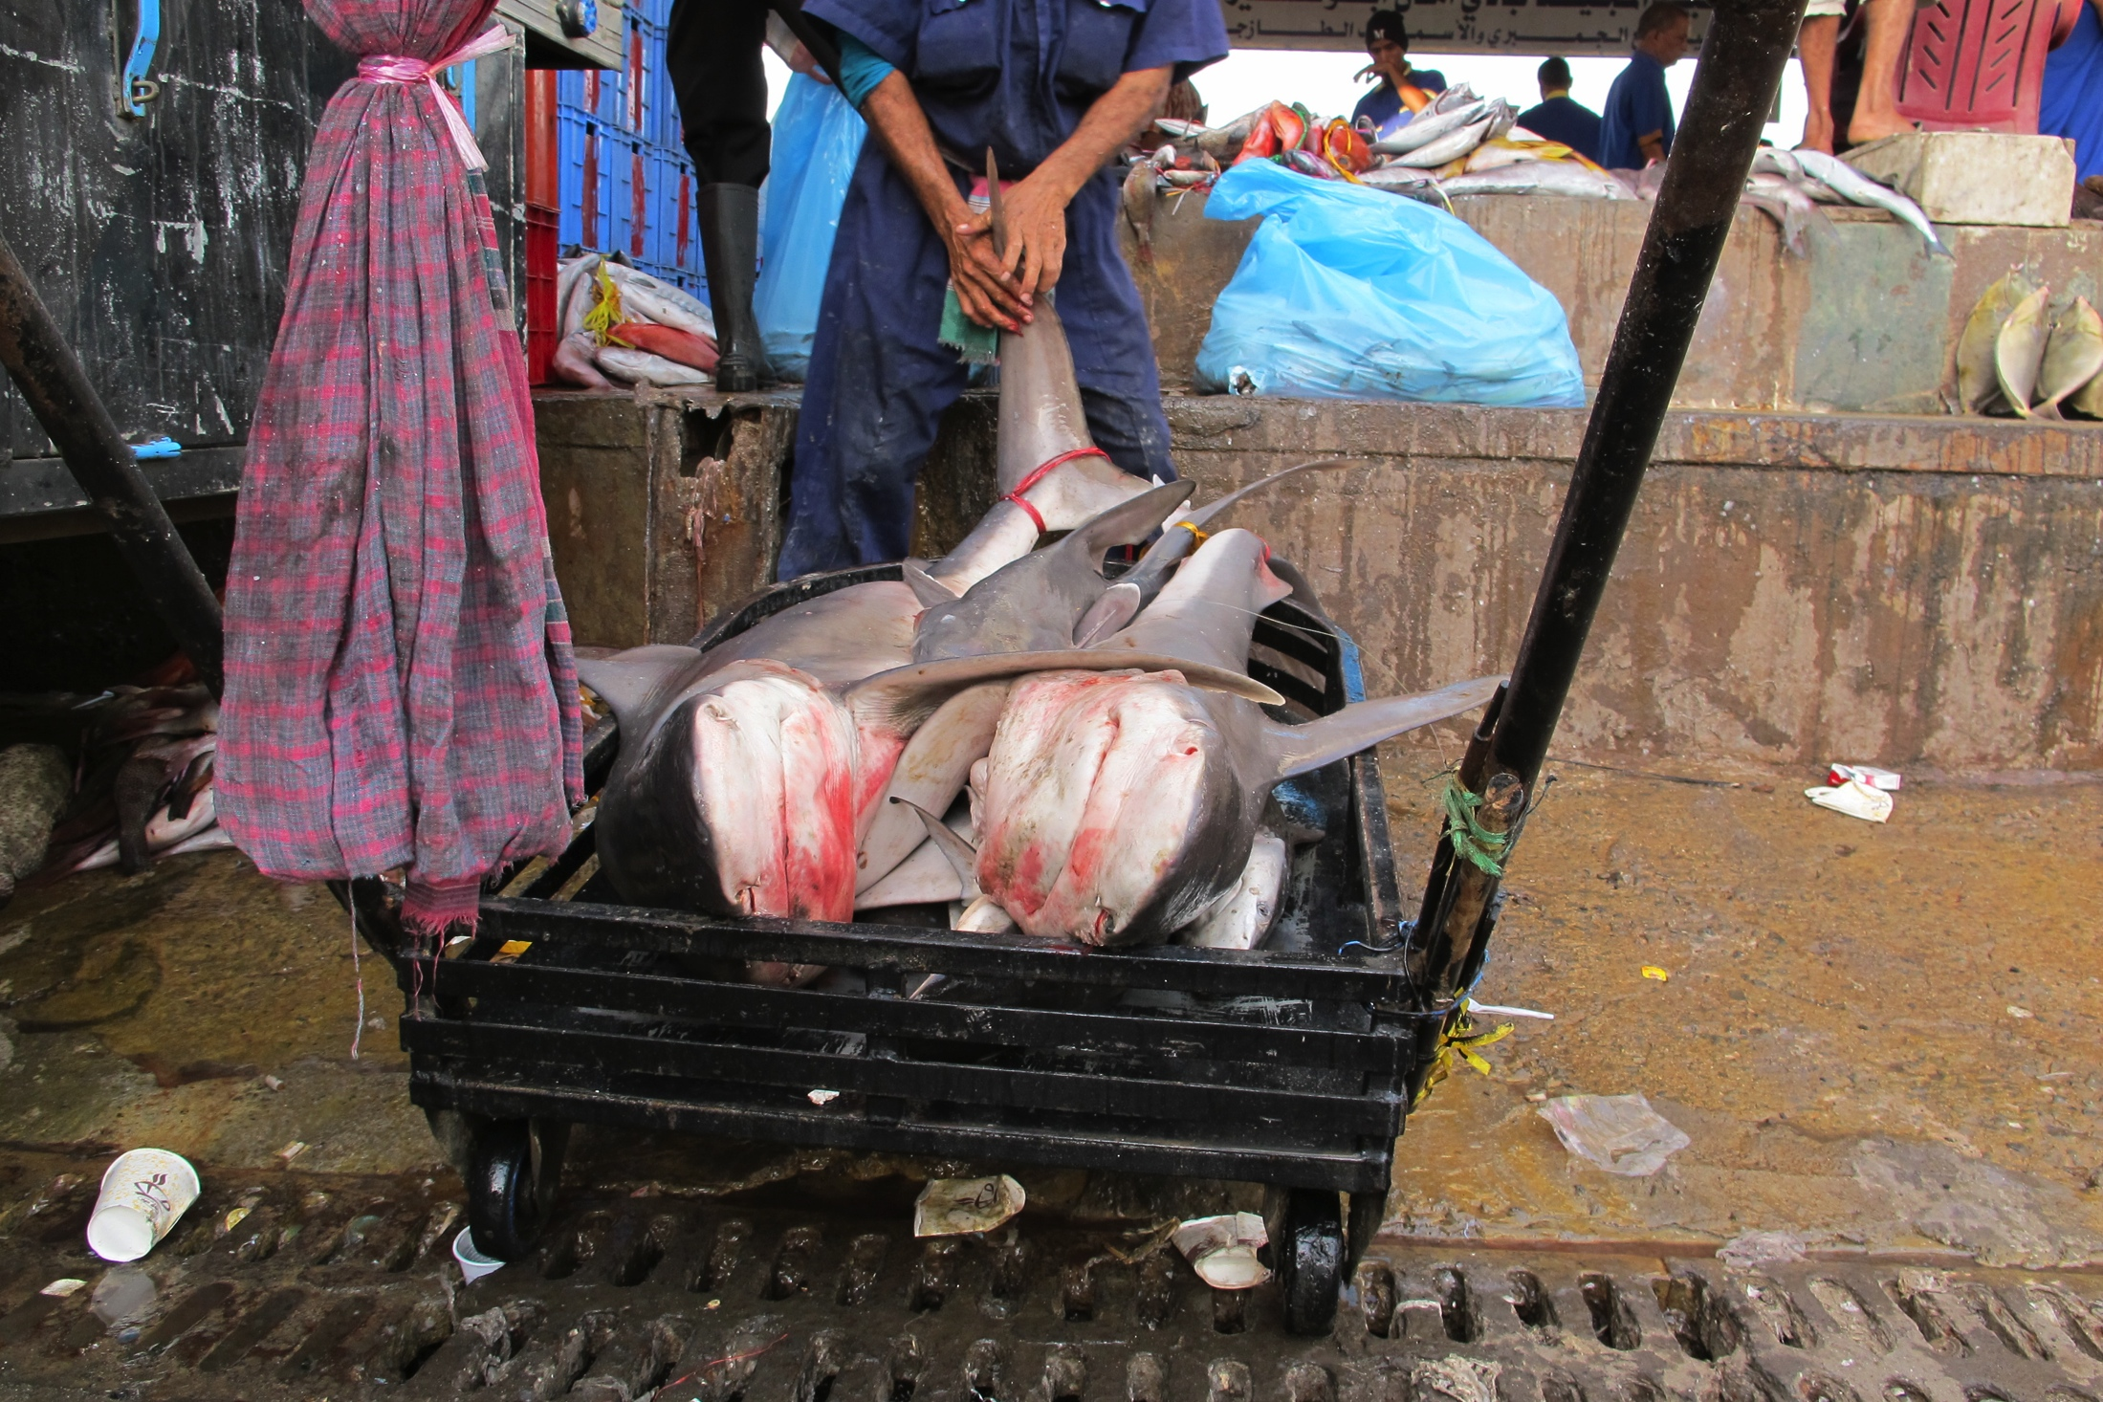
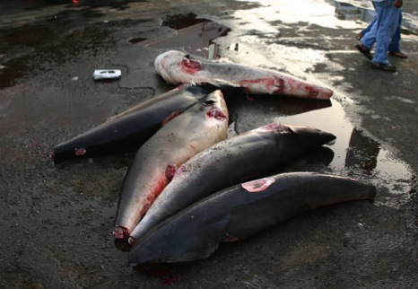
Current
knowledge
Project
objectives
Market
surveys
Fishermen
Interviews
BRUVS/
Longlines
Future
research
T. obesus
Other
Reef
C. melanopterus
L. macrorhinus
R. acutus
C. amblyrhynchos
S. mokarran
Project
Objectives
S. lewini
C. sorrah
C. brevipinna
C. falciformis
Reef associated
n= 1094
Red Sea Research Center
King Abdullah University of Science and Technology
Notes:
I have been conducting bi-monthly surveys at Saudi Arabia’s biggest fish market in Jeddah for a little over a year now. There is actually a law prohibiting the catching and landing of sharks in Saudi Red Sea waters, both for targeted and bycatch fisheries, however no one really seems to care. So every day in the morning they are auctioning between 30-100. So far I have sampled a little over 1000 sharks during this survey comprising 24 species. Many of the species occur rather infrequently and the commercial harvest is dominated by a relatively small number of Carcharhinids and Sphyrnids most of them being reef or reef associated sharks. Spottail and grey reef sharks are the most important followed by silky and spinner sharks.
9

Slide 10
Current
knowledge
Project
objectives
Market
surveys
Fishermen
Interviews
BRUVS/
Longlines
Future
research
Numerical abundance
Total length (cm)
Red Sea Research Center
King Abdullah University of Science and Technology
Notes:
If we look at the size structure , shark catches are dominated by small and medium sized sharks, which are mostly juveniles of bigger Carcharhinids.
10

Slide 11
Current
knowledge
Project
objectives
Market
surveys
Fishermen
Interviews
BRUVS/
Longlines
Future
research
C. falciformis
n= 160
composition
C. amblyrhynchos
n= 173
Total length (mm)
Red Sea Research Center
King Abdullah University of Science and Technology
Notes:
The structure of the catches indicates that the fisheries catch very large amounts of juvenile sharks of many species.

Slide 12
Current
knowledge
Project
objectives
Market
surveys
Fishermen
Interviews
BRUVS/
Longlines
Future
research
S. lewini
n= 89
C. brevipinna
n= 110
C. sorrah
n= 173
composition
Total length (mm)
Red Sea Research Center
King Abdullah University of Science and Technology
Notes:
Of particular concern is the heavy fishing of juvenile and newborn scalopped hammerhead, spinner and spottail sharks, which are heavily fished in the 50-80 cm size class, indicating that fishermen are targeting this group in nursery areas in their first year of life.

Slide 13
Current
knowledge
Project
objectives
Market
surveys
Fishermen
Interviews
BRUVS/
Longlines
Future
research
C. amblyrhynchos
Males (101)
Females (72)
Percent
1:1 sex ratio
p = 0.0275
size (mm)
Red Sea Research Center
King Abdullah University of Science and Technology
Notes:
For the majority of species, sex ratios do not differ significantly from parity. For grey reef sharks however, samples show a significant departure from parity towards males. Which might be due to a number of confounding factors, e.g. gear bias or natural selection, which has been reported in grey reef sharks but obviously it’s difficult to interpret shark sex ratio data from landings only.

Slide 14
Current
knowledge
Project
objectives
Market
surveys
Fishermen
Interviews
BRUVS/
Longlines
Future
research
Numerical abundance
Red Sea Research Center
King Abdullah University of Science and Technology
Notes:
Among seasons the assemblage for reef or reef associated species does not differ significantly. We have very high numbers of spottail landings in March which are comprised of exclusively juveniles. Then we have a very high number of landings in the category “other sharks” in December, those are almost exclusively comprised of newborn Scallopped Hammerhead sharks.
14

Slide 15
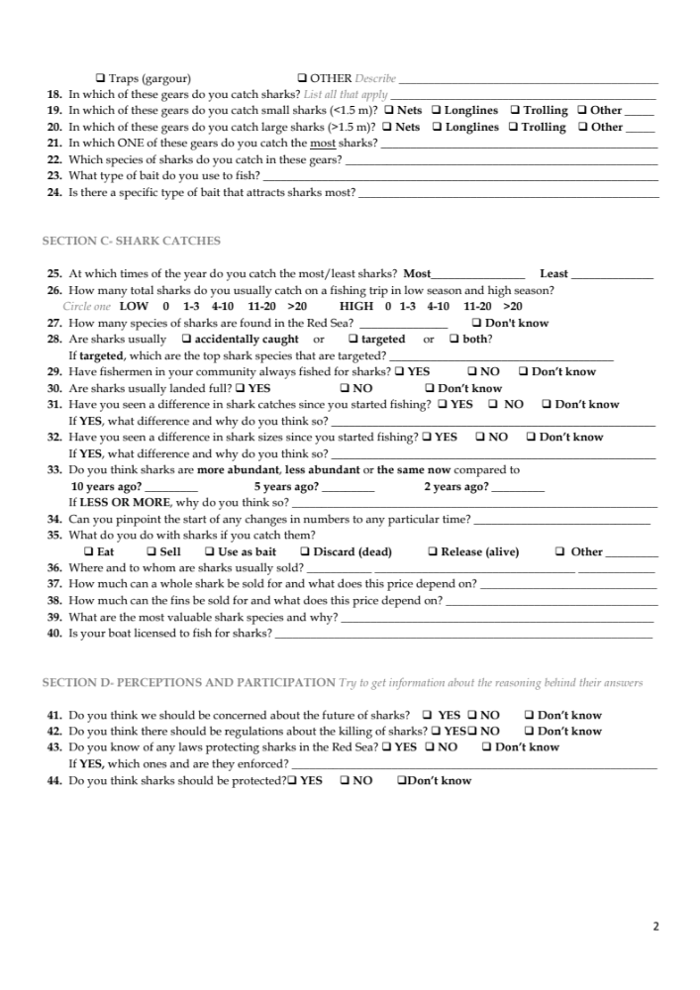
Current
knowledge
Project
objectives
Market
surveys
Fishermen
Interviews
BRUVS/
Longlines
Future
research
Shark fisheries
Response rate
n=50
Red Sea Research Center
King Abdullah University of Science and Technology
Notes:
In addition to the market surveys I have recently started to interview fishermen asking them questions about their attitude towards sharks, their shark fishing practices and the changes in shark abundance over the past 20 years. A little over 50% of the respondents stated that they would exclusively target teleosts and sharks were only caught accidentally. While almost the same number of interviewees stated that they would specifically target sharks in addition to teleosts.

Slide 16
Current
knowledge
Project
objectives
Market
surveys
Fishermen
Interviews
BRUVS/
Longlines
Future
research
Shark abundance –
now compared to 5-10 years ago
Shark declines - reasons
Response rate
n=50
Red Sea Research Center
King Abdullah University of Science and Technology
Notes:
When asked about recent changes in shark abundance over 70% of fishermen stated that they have seen a decline in sharks within the past 10 years for which they give a range of different reasons. Most of them believe that the heavy fishing on prey fish is responsible for the decline.
16

Slide 17
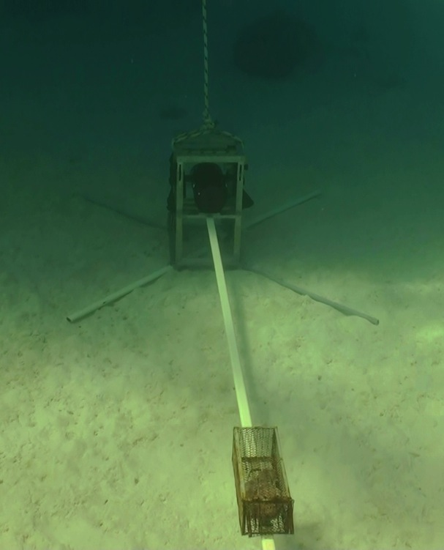
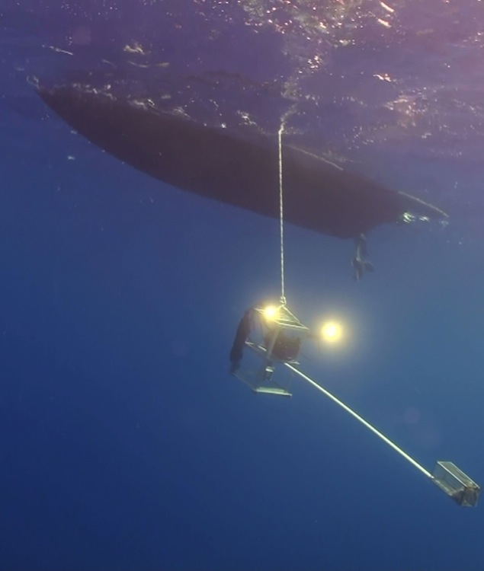
Current
knowledge
Project
objectives
Market
surveys
Fishermen
Interviews
BRUVS/
Longlines
Future
research
Deployment
time: 00:00 – 12:00
duration: 2.5 hours
depth: 1-200 m
number (total): 85
hours (total): 170
Red Sea Research Center
King Abdullah University of Science and Technology
Notes:
One of the fisheries-independent survey methods I have chosen are baited remote underwater video surveys which I have conducted for over a year now. The topography of the Red Sea makes it a little difficult to deploy BRUVS at random sites. Most reefs have very steep drop offs, sometimes down to 2 thousand meters. I am therefore usually deploying them on small reef plateaus when necessary on scuba and whenever no plateaus are available I have them just dangling off a zodiac. Deployment times are 2.5 hours in depths between 1-200m and I have been sampling both, during day and night time.
17

Slide 18
Current
knowledge
Project
objectives
Market
surveys
Fishermen
Interviews
BRUVS/
Longlines
Future
research
Deployment
time: 00:00 – 12:00
duration: 2.5 hours
depth: 1-200 m
number (total): 85
hours (total): 170
Red Sea Research Center
King Abdullah University of Science and Technology
Notes:
One of the fisheries-independent survey methods I have chosen are baited remote underwater video surveys which I have conducted for over a year now. The topography of the Red Sea makes it a little difficult to deploy BRUVS at random sites. Most reefs have very steep drop offs, sometimes down to 2 thousand meters. I am therefore usually deploying them on small reef plateaus when necessary on scuba and whenever no plateaus are available I have them just dangling off a zodiac. Deployment times are 2.5 hours in depths between 1-200m and I have been sampling both, during day and night time.
18

Slide 19
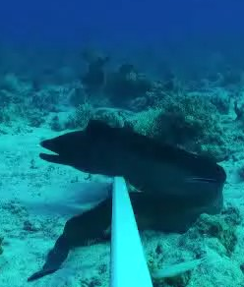
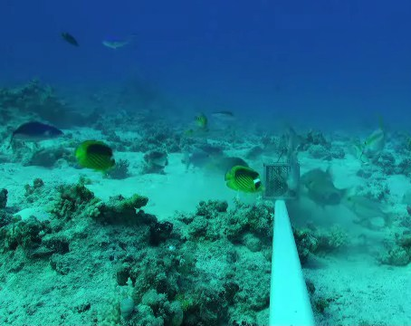
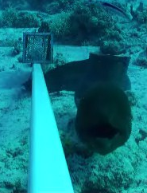
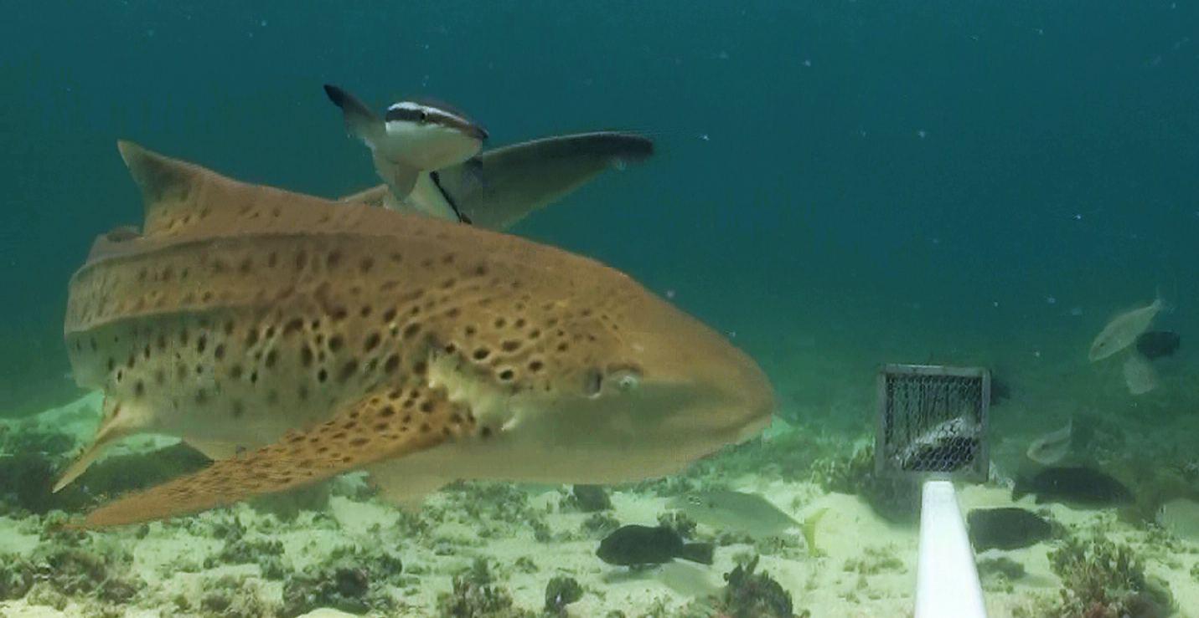
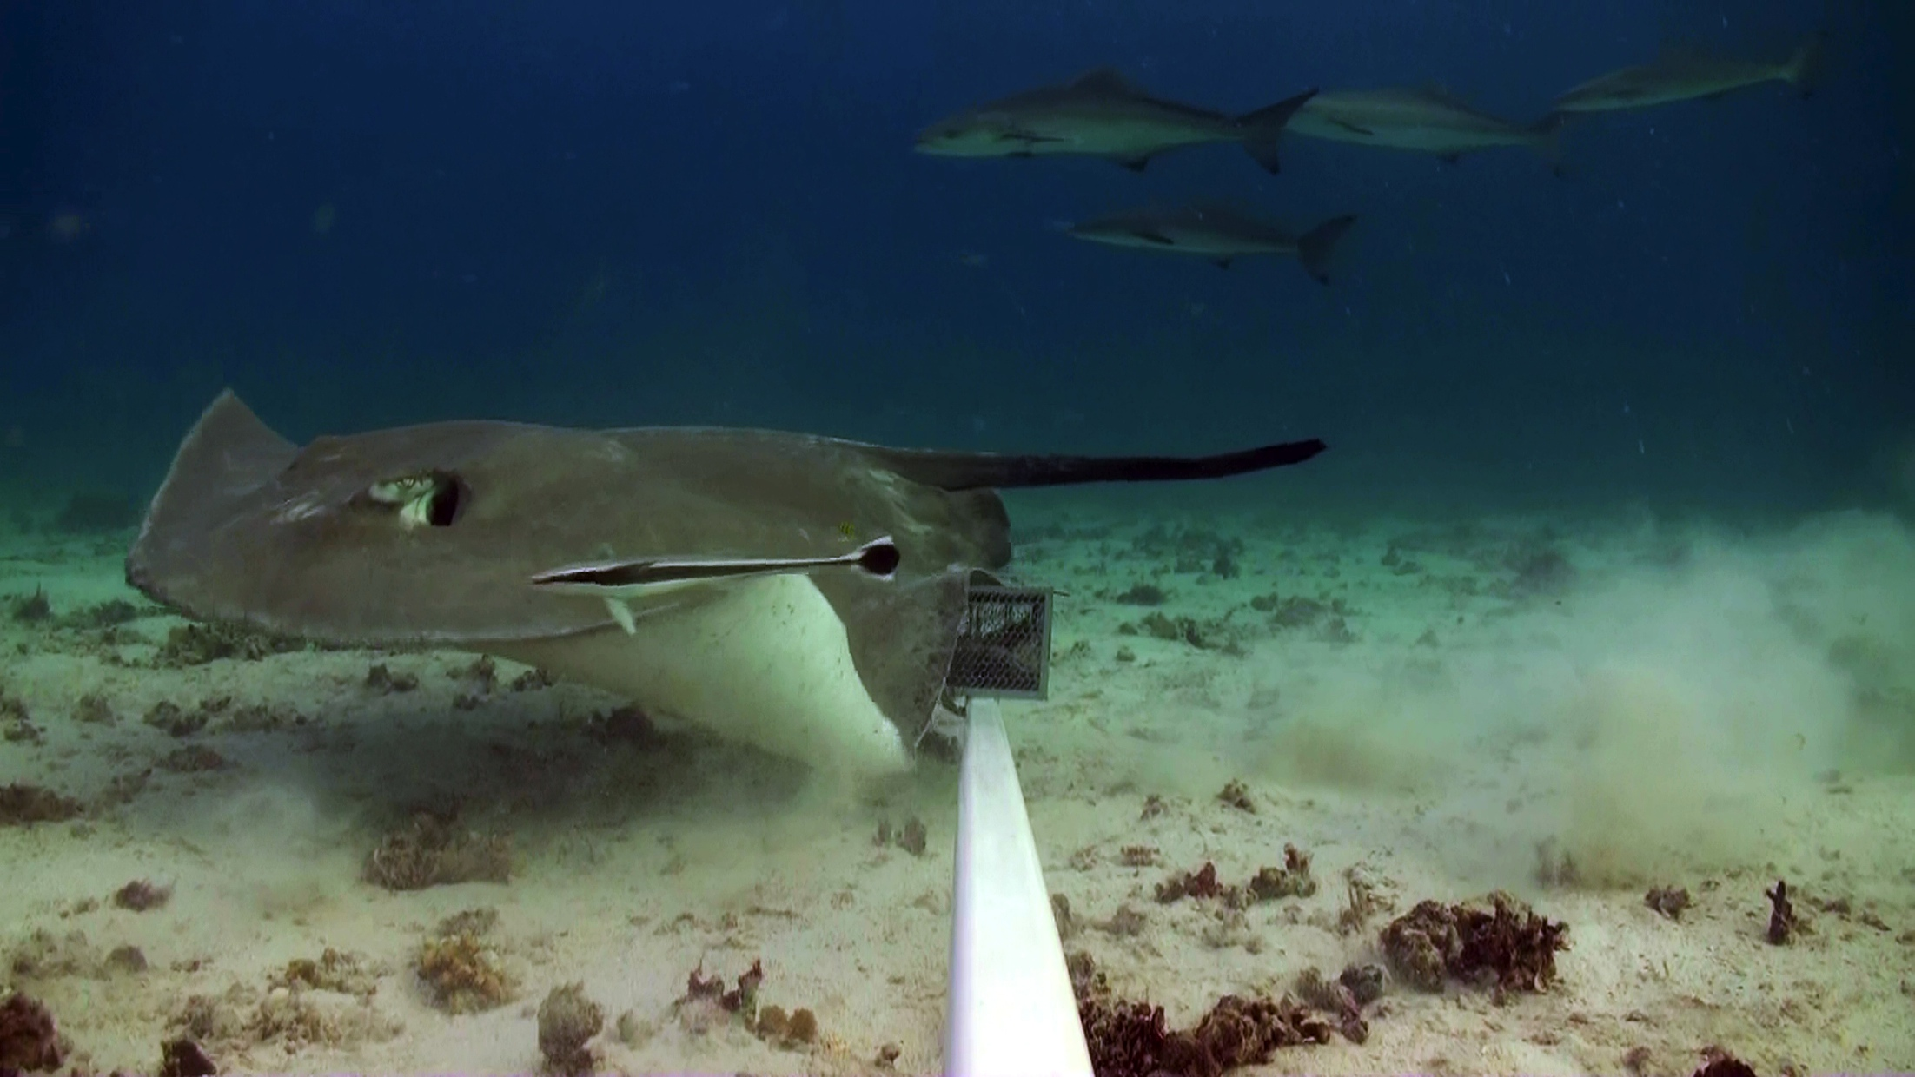
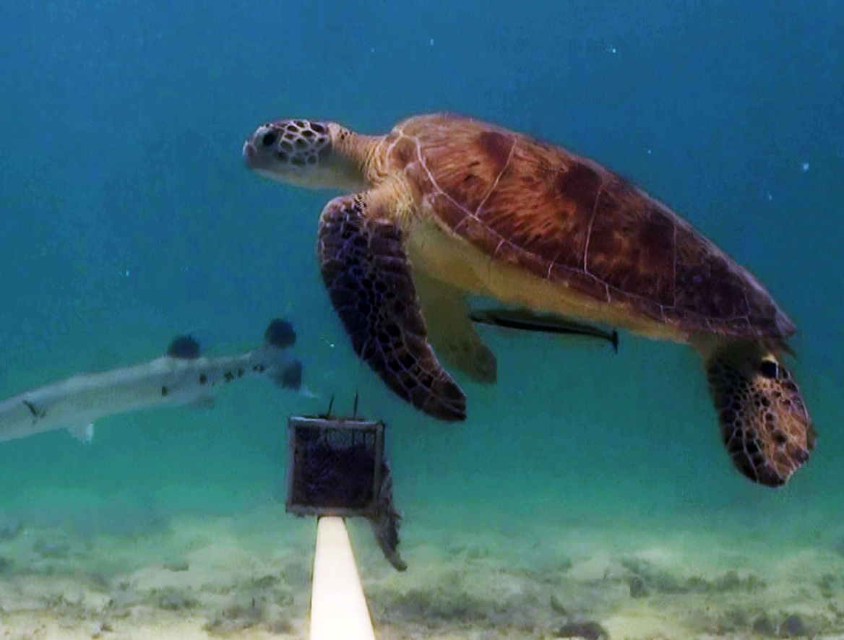
Current
knowledge
Project
objectives
Market
surveys
Fishermen
Interviews
BRUVS/
Longlines
Future
research
Number of sharks/hour
North & Central
Number of sharks/hour
200 km
South
Red Sea Research Center
King Abdullah University of Science and Technology
Notes:
I started with the surveys in the central Red Sea and got pretty frustrated after a while as I just didn’t get any sharks. So I moved up the coast and sampled almost all the way to the Gulf of Aqaba. 4 weeks later I had seen lost and lots of Giant mooray eels and smaller reef fish but only two sharks. In May this year I moved all the way South to a group of islands called the Farasan Islands near the Yemeni boarder. The Farasan islands are the only marine protected area in entire Saudi Arabia but even though, there is some effective enforcement against mostly Yemeni fishing boats trying to come in from the South a real protection for sharks doesn’t exist and a lot of bigger fishing vessels come to the islands on over night stays to longline for sharks. Still a huge difference in not only shark abundances but of marine diversity in general was visible. The CPUE of shark sightings in the South was actually 20 times higher compared to the North and Central Red Sea. However, the only sharks I encountered were nurse and zebra sharks. Nurse and Zebra sharks are the only two species that are not targeted by the fishermen and that are usually released alive when accidentally caught.
19

Slide 20
Current
knowledge
Project
objectives
Market
surveys
Fishermen
Interviews
BRUVS/
Longlines
Future
research
Australia
Fiji
Marianna Islands
Bahamas
Red Sea
Number of sharks per hour
CPUE: 0.04
unfished fished unfished fished unfished fished
References: Meekan et al. 2006; Goetze and Fullwod, Coral Reefs (submitted); Lindfield unpublished; Brooks et al. 2011
Red Sea Research Center
King Abdullah University of Science and Technology
Notes:
If we combine the two very different CPUE numbers for the entire Red Sea and compare the result to BRUV studies conducted at other places around the world the position of the Red Sea is quite shocking.
20

Slide 21
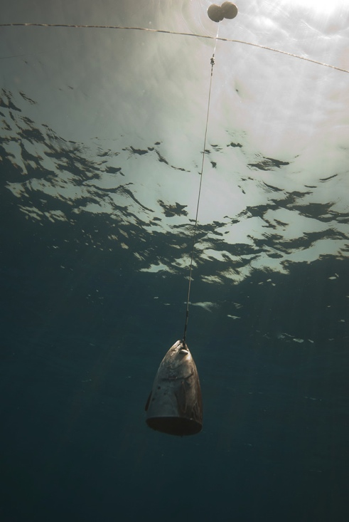
Current
knowledge
Project
objectives
Market
surveys
Fishermen
Interviews
BRUVS/
Longlines
Future
research
Number of sharks hook⁻¹ h⁻¹
References: Pikitch et al. 2005; Dale et al. 2011; Brooks et al. 2011
Red Sea Research Center
King Abdullah University of Science and Technology
Notes:
We see similar results if we compare CPUE data of scientific longline surveys, which I recently started to conduct in the Red Sea to surveys in e.g. the Caribbean and Hawaii. Again the numbers of sharks per hook hour I get for the Red Sea are far below any other regions.
21

Slide 22
Current
knowledge
Project
objectives
Market
surveys
Fishermen
Interviews
BRUVS/
Longlines
Future
research
Shark
abundance
Response rate
Australia
Fiji
Marianna Islands
Bahamas
Red Sea
Number of sharks hook⁻¹h-¹
Number of sharks per hour
Red Sea Research Center
King Abdullah University of Science and Technology
Notes:
So overall the data I have collected so far doesn’t show very encouraging and it seems like the Red Sea populations are in serious trouble. Unfortunately I am not sure if much is going to change in the near future concerning the protection of sharks. We will of course try and use this data in the best possible way and continue and expand the research.
22

Slide 23
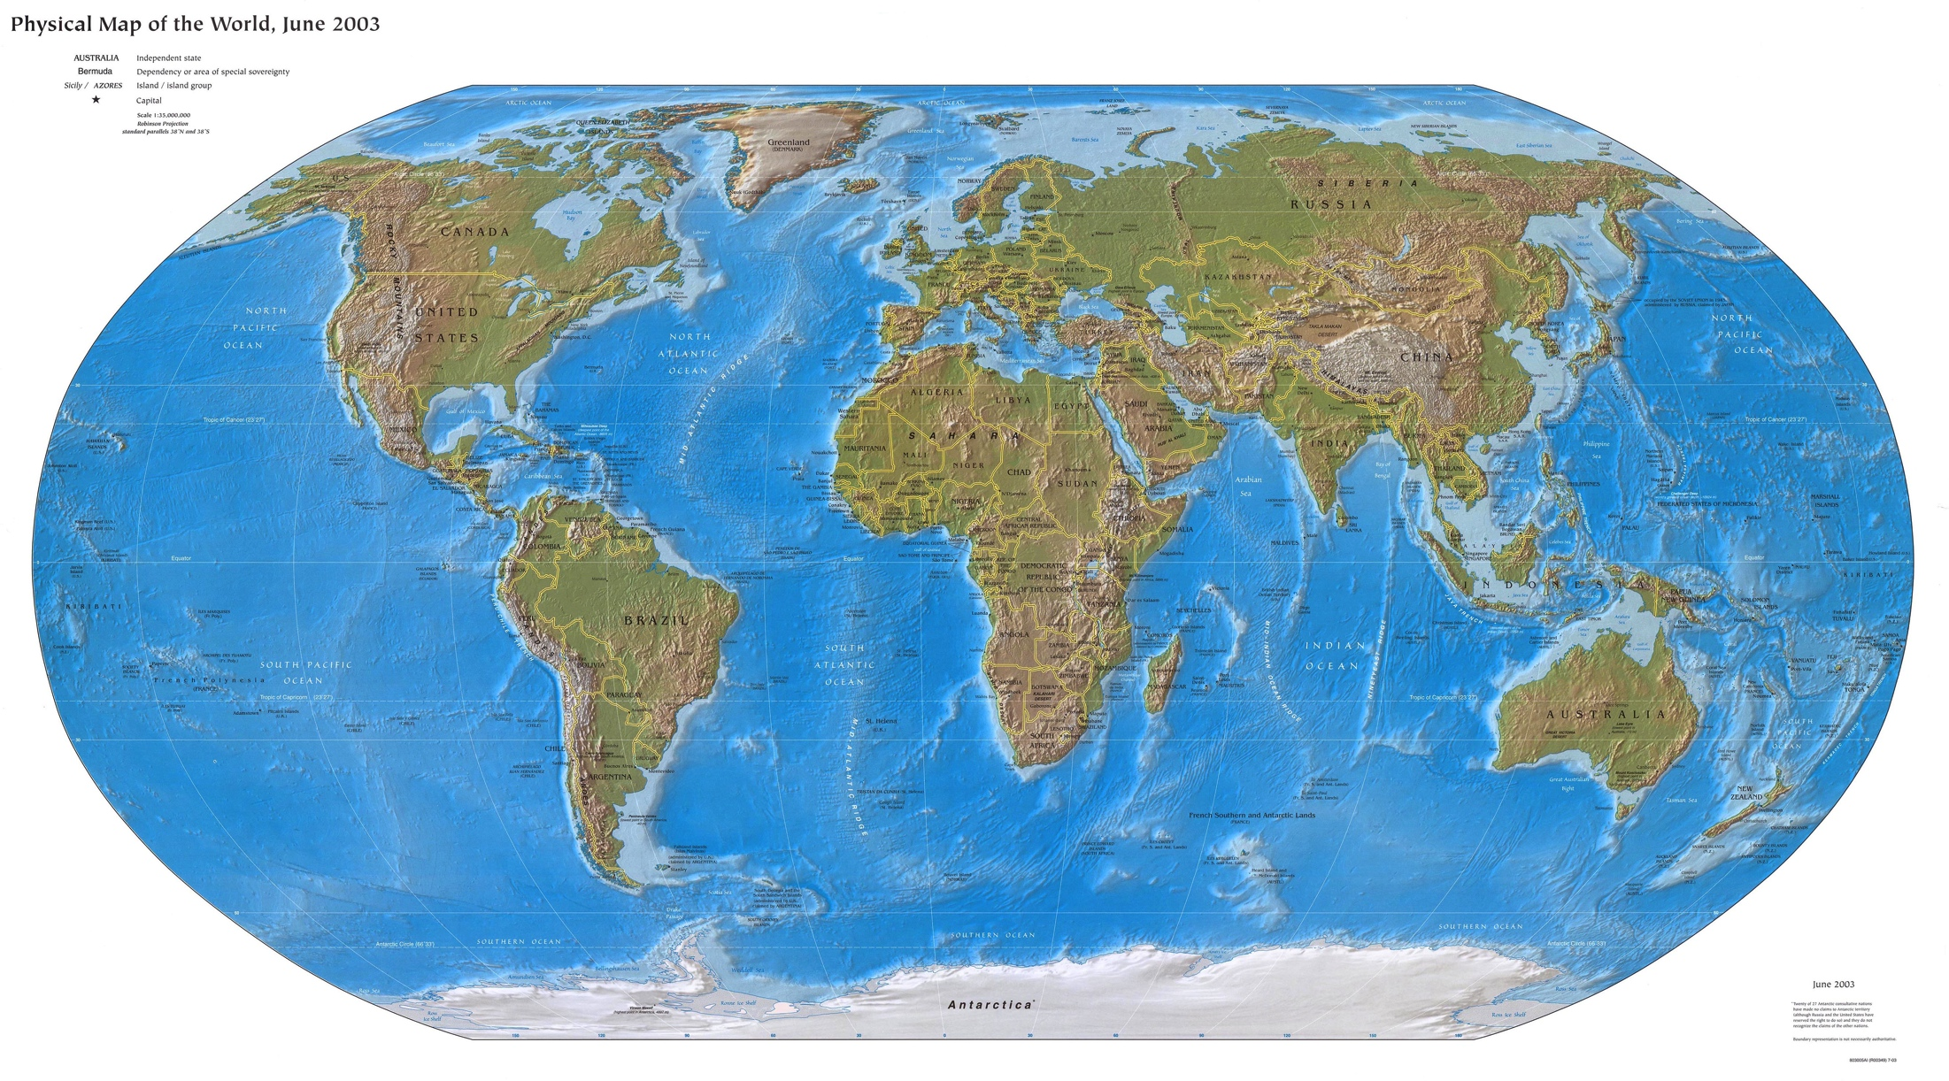
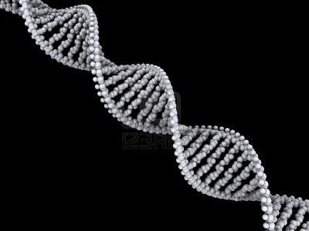
Current
knowledge
Project
objectives
Market
surveys
Fishermen
Interviews
BRUVS/
Longlines
Future
research
C. melanopterus
Large scale population dynamics
C. amblyrhynchos
Red Sea Research Center
King Abdullah University of Science and Technology
Notes:
Currently the blacktip reef shark samples collected during the market surveys are being analysed in the context of large scale population dynamics, I think you might hear some preliminary results in a talk this afternoon. For grey reef sharks a similar analysis is planned
23

Slide 24
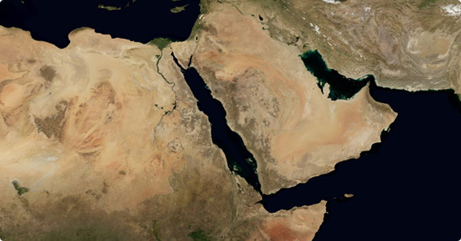
Current
knowledge
Project
objectives
Market
surveys
Fishermen
Interviews
BRUVS/
Longlines
Future
research
C. falciformis
R. acutus
S. lewini
S. mokarran
Regional
Population dynamics
C. sorrah
Red Sea Research Center
King Abdullah University of Science and Technology
Notes:
Also I am currently analysing the dynamics between Red Sea, Gulf and Indian Ocean populations of silky, milk, hammerhead and spottail sharks
24

Slide 25
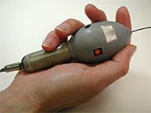
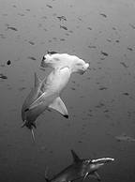
Current
knowledge
Project
objectives
Market
surveys
Fishermen
Interviews
BRUVS/
Longlines
Future
research
S. lewini
Movement
Patterns
Red Sea Research Center
King Abdullah University of Science and Technology
Notes:
Also I am currently analysing the dynamics between Red Sea, Gulf and Indian Ocean populations of silky, milk, hammerhead and spottail sharks
25

Slide 26
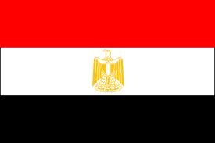

Current
knowledge
Project
objectives
Market
surveys
Fishermen
Interviews
BRUVS/
Longlines
Future
research
Egypt
Saudi Arabia
Sudan
Regional
survey
extension
Red Sea Research Center
King Abdullah University of Science and Technology
Notes:
Also I am currently analysing the dynamics between Red Sea, Gulf and Indian Ocean populations of silky, milk, hammerhead and spottail sharks
26

Slide 27

Acknowledgements:
Fish market, BRUVS and longline volunteers
Safe our Seas Foundation
for financial support to attend ICRS
Coastal and Marine Resources Core Lab (CMOR)
Dream Divers, Jeddah, Saudi Arabia
Red Sea Research Center
King Abdullah University of Science and Technology
Notes:
All sharks I have encountered so far were landed and marketed whole, with no direct evidence of removal of fins at sea. Sometimes fins are removed from sharks by stallholders upon sale for consumption, apparently for onward sale to Yemen.
27

Slide 28
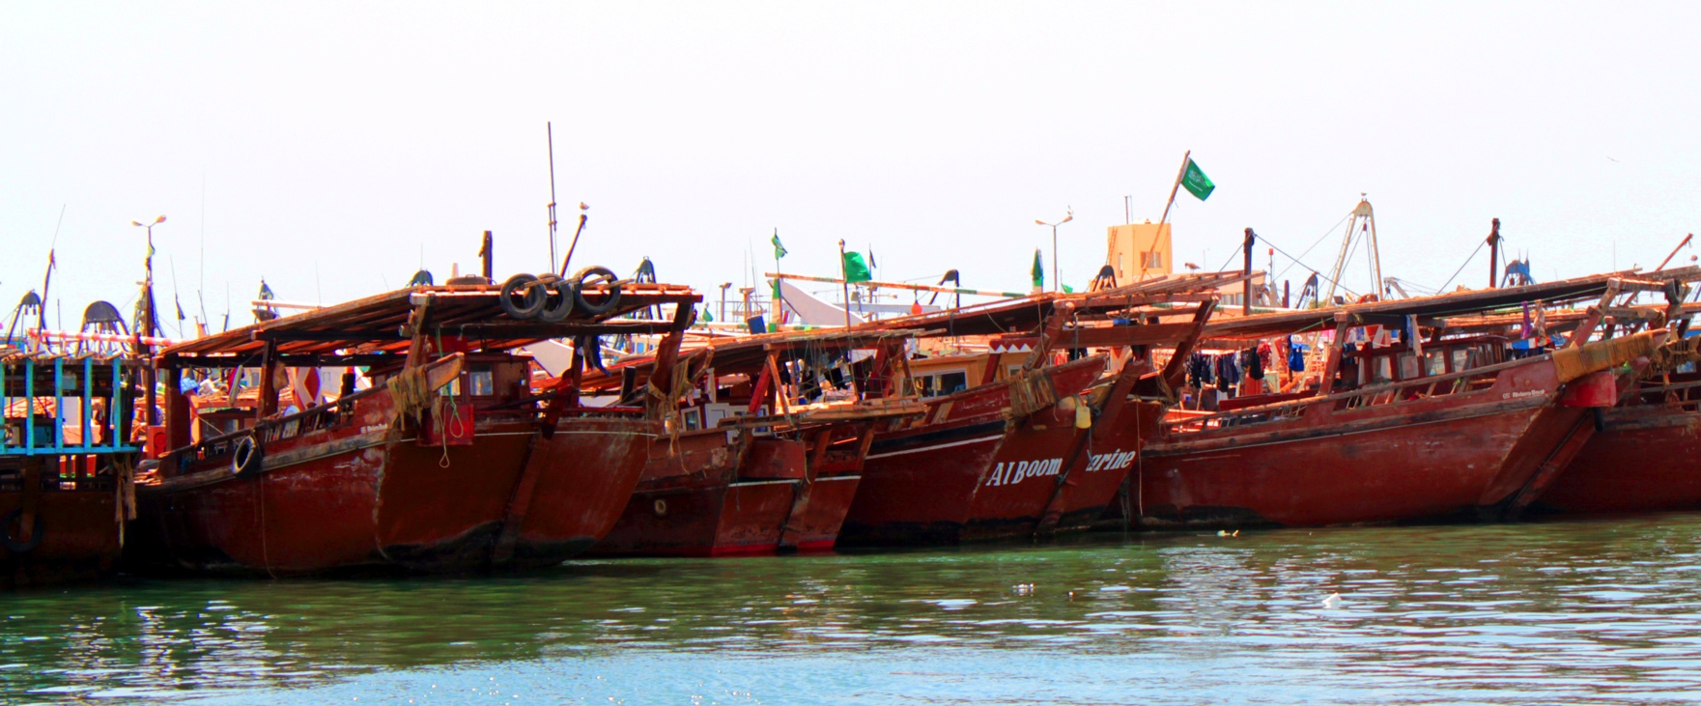
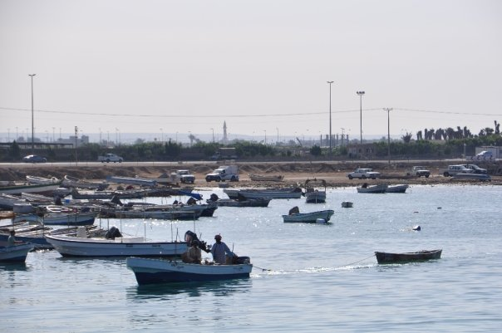
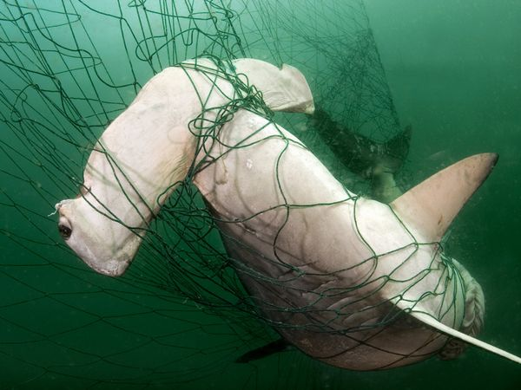
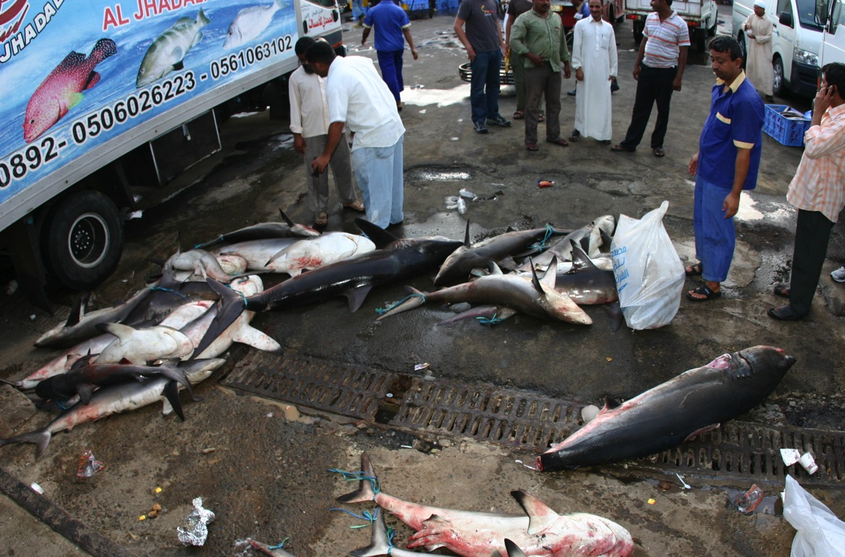
Current
knowledge
Project
objectives
Market
surveys
Fishermen
Interviews
BRUVS/
Longlines
Future
research
US$ 300
US$ 100
US$ 15
200 km
US$ 30
Red Sea Research Center
King Abdullah University of Science and Technology
Notes:
There are 5 major fishing regions in Saudi Arabia but around 98% of the sharks brought to the market in Jeddah originate from the most Southern region. Most sharks are landed by small open speedboats which are operating gillnets to target teleosts in local, coastal waters and then they are shipped by truck to Jeddah. In addition to small gillnetters, fishermen also operate larger so called dhows also mostly in the South. These dhows also land large sharks from longline fishing as a targeted activity. Prices vary considerably depending on species, size and weight, the most expensive shark I have ever encountered was a 2.5 m mako which was sold for $700 US but sharks under 1 m are often sold for less than $1 US .

